Slide 1
Propositional Logic Summary
The Language of Propositions
  Connectives
  Truth Values
  Truth Tables
Logical Equivalences
  Important Equivalences
  Showing Equivalence

Slide 2
Propositional Logic
Section 1.1

Slide 3
Section Summary
Propositions
Connectives
  Negation
  Conjunction
  Disjunction
  Implication; contrapositive, inverse, converse
  Biconditional
Truth Tables

Slide 4
Propositions
A proposition is a declarative sentence that is either true or false.
Examples of propositions:
  The Moon is made of green cheese.
  Trenton is the capital of New Jersey.
  Toronto is the capital of Canada.
  1 + 0 = 1
  0 + 0 = 2
Examples that are not propositions.
  Sit down!
  What time is it?
  x + 1 = 2
  x + y = z

Slide 5
Propositional Logic
Constructing Propositions
  Propositional Variables: p, q, r, s, …
  The proposition that is always true is denoted by T and the proposition that is always false is denoted by F.
  Compound Propositions; constructed from logical connectives and other propositions
    Negation ¬
    Conjunction ∧
    Disjunction ∨
    Implication →
    Biconditional ↔

Slide 6
Compound Propositions: Negation
  The negation of a proposition p is denoted by ¬p and has this truth table:
Example: If p denotes “The earth is round.”, then ¬p denotes “It is not the case that the earth is round,” or more simply “The earth is not round.”
p | ¬p
T | F
F | T

Slide 7
Conjunction
The conjunction of propositions p and q is denoted by p ∧ q and has this truth table:
Example: If p denotes “I am at home.” and q denotes “It is raining.” then p ∧q denotes “I am at home and it is raining.”
p | q | p ∧ q
T | T | T
T | F | F
F | T | F
F | F | F

Slide 8
Disjunction
The disjunction of propositions p and q is denoted by p ∨q and has this truth table:
Example: If p denotes “I am at home.” and q denotes “It is raining.” then p ∨q denotes “I am at home or it is raining.”
p | q | p ∨q
T | T | T
T | F | T
F | T | T
F | F | F

Slide 9
The Connective Or in English
In English “or” has two distinct meanings.
  “Inclusive Or” - In the sentence “Students who have taken CS202 or Math120 may take this class,” we assume that students need to have taken one of the prerequisites, but may have taken both. This is the meaning of disjunction. For p ∨q to be true, either one or both of p and q must be true.
  “Exclusive Or” - When reading the sentence “Soup or salad comes with this entrée,” we do not expect to be able to get both soup and salad. This is the meaning of Exclusive Or (Xor). In p ⊕ q , one of p and q must be true, but not both. The truth table for ⊕ is:
p | q | p ⊕q
T | T | F
T | F | T
F | T | T
F | F | F

Slide 10
Implication
If p and q are propositions, then p →q is a conditional statement or implication which is read as “if p, then q ” and has this truth table:
Example: If p denotes “I am at home.” and q denotes “It is raining.” then p →q denotes “If I am at home then it is raining.”
In p →q , p is the hypothesis (antecedent or premise) and q is the conclusion (or consequence).
p | q | p →q
T | T | T
T | F | F
F | T | T
F | F | T

Slide 11
Understanding Implication
  In p →q there does not need to be any connection between the antecedent or the consequent. The “meaning” of p →q depends only on the truth values of p and q.
These implications are perfectly fine, but would not be used in ordinary English.
  “If the moon is made of green cheese, then I have more money than Bill Gates. ”
  “If the moon is made of green cheese then I’m on welfare.”
  “If 1 + 1 = 3, then your grandma wears combat boots.”

Slide 12
Understanding Implication (cont)
One way to view the logical conditional is to think of an obligation or contract.
  “If I am elected, then I will lower taxes.”
  “If you get 100% on the final, then you will get an A.”
If the politician is elected and does not lower taxes, then the voters can say that he or she has broken the campaign pledge. Something similar holds for the professor. This corresponds to the case where p is true and q is false.

Slide 13
Different Ways of Expressing p →q
if p, then q p implies q
if p, q p only if q
q unless ¬p q when p
q if p q when p
q whenever p p is sufficient for q
q follows from p q is necessary for p
a necessary condition for p is q
a sufficient condition for q is p

Slide 14
Converse, Contrapositive, and Inverse
From p →q we can form new conditional statements .
  q →p is the converse of p →q
  ¬q → ¬ p is the contrapositive of p →q
  ¬ p → ¬ q is the inverse of p →q
Example: Find the converse, inverse, and contrapositive of “It raining is a sufficient condition for my not going to town.”
Solution:
  converse: If I do not go to town, then it is raining.
  inverse: If it is not raining, then I will go to town.
  contrapositive: If I go to town, then it is not raining.

Slide 15
Biconditional
If p and q are propositions, then we can form the biconditional proposition p ↔q , read as “p biconditional q .” The biconditional p ↔q denotes the proposition with this truth table:
If p denotes “I am at home.” and q denotes “It is raining.” then p ↔q denotes “I am at home biconditional it is raining.”
p | q | p ↔q
T | T | T
T | F | F
F | T | F
F | F | T

Slide 16
Truth Tables For Compound Propositions
Construction of a truth table:
Rows
  Need a row for every possible combination of values for the atomic propositions.
Columns
  Need a column for the compound proposition (usually at far right)
  Need a column for the truth value of each expression that occurs in the compound proposition as it is built up.
    This includes the atomic propositions

Slide 17
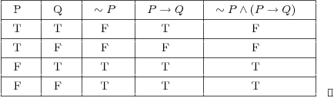

Slide 18
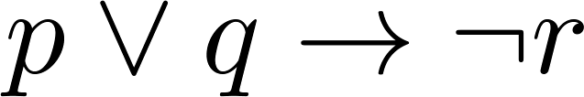
Example Truth Table
Construct a truth table for
p | q | r | ¬r | p ∨ q | p ∨ q → ¬r
T | T | T | F | T | F
T | T | F | T | T | T
T | F | T | F | T | F
T | F | F | T | T | T
F | T | T | F | T | F
F | T | F | T | T | T
F | F | T | F | F | T
F | F | F | T | F | T

Slide 19
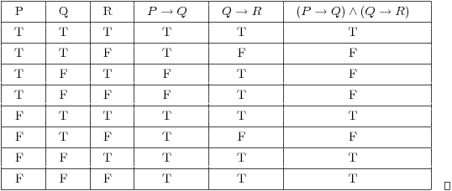

Slide 20
Equivalent Propositions
Two propositions are equivalent if they always have the same truth value.
Example: Show using a truth table that an implication is equivalent to its contrapositive.
Solution:
p | q | ¬ p | ¬ q | p →q | ¬q → ¬ p
T | T | F | F | T | T
T | F | F | T | F | F
F | T | T | F | T | T
F | F | T | T | T | T

Slide 21
Using a Truth Table to Show Non-Equivalence
Example: Show using truth tables that neither the converse nor inverse of an implication are not equivalent to the implication.
Solution:
p | q | ¬ p | ¬ q | p →q | ¬ p →¬ q | q → p
T | T | F | F | T | T | T
T | F | F | T | F | T | T
F | T | T | F | T | F | F
F | F | T | T | T | T | T

Slide 22
Precedence of Logical Operators
Operator | Precedence
¬ | 1
∧ ∨ | 2 3
→ ↔ | 4 5
p ∨q → ¬r is equivalent to (p ∨q) → ¬r
If the intended meaning is p ∨(q → ¬r )
then parentheses must be used.

Slide 23
Problem
How many rows are there in a truth table with n propositional variables?
Solution: 2^{n} We will see how to do this in Chapter 6.
Note that this means that with n propositional variables, we can construct 2^{n} distinct (i.e., not equivalent) propositions.

Slide 24
Propositional Logic Summary
The Language of Propositions
  Connectives
  Truth Values
  Truth Tables
Logical Equivalences
  Important Equivalences
  Showing Equivalence

Slide 25
Applications of Propositional Logic
Section 1.2

Slide 26
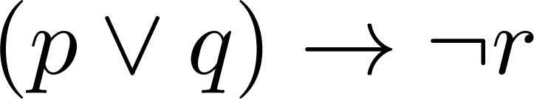
Translating English Sentences
Steps to convert an English sentence to a statement in propositional logic
  Identify atomic propositions and represent using propositional variables.
  Determine appropriate logical connectives
“If I go to Harry’s or to the country, I will not go shopping.”
  p: I go to Harry’s
  q: I go to the country.
  r: I will go shopping.
If p or q then not r.

Slide 27
Propositional Equivalences
Section 1.3

Slide 28
Section Summary
Tautologies, Contradictions, and Contingencies.
Logical Equivalence
  Important Logical Equivalences
  Showing Logical Equivalence

Slide 29
Tautologies, Contradictions, and Contingencies
A tautology is a proposition which is always true.
  Example: p ∨¬p
A contradiction is a proposition which is always false.
  Example: p ∧¬p
A contingency is a proposition which is neither a tautology nor a contradiction, such as p
P | ¬p | p ∨¬p | p ∧¬p
T | F | T | F
F | T | T | F

Slide 30
Logically Equivalent
Two compound propositions p and q are logically equivalent if p↔q is a tautology.
We write this as p⇔q or as p≡q where p and q are compound propositions.
Two compound propositions p and q are equivalent if and only if the columns in a truth table giving their truth values agree.
This truth table show ¬p ∨ q is equivalent to p → q.
p | q | ¬p | ¬p ∨ q | p→ q
T | T | F | T | T
T | F | F | F | F
F | T | T | T | T
F | F | T | T | T

Slide 31
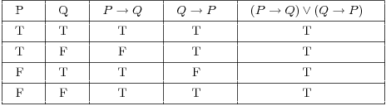

Slide 32
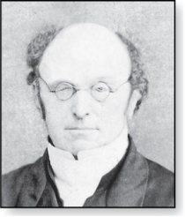
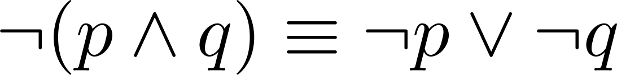
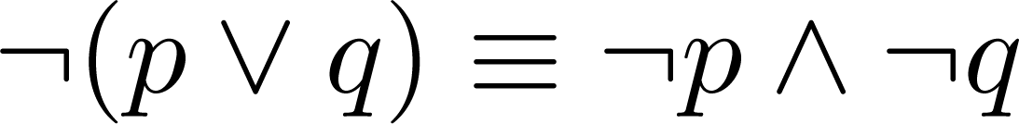
De Morgan’s Laws
Augustus De Morgan
1806-1871
This truth table shows that De Morgan’s Second Law holds.
p | q | ¬p | ¬q | (p∨q) | ¬(p∨q) | ¬p∧¬q
T | T | F | F | T | F | F
T | F | F | T | T | F | F
F | T | T | F | T | F | F
F | F | T | T | F | T | T

Slide 33
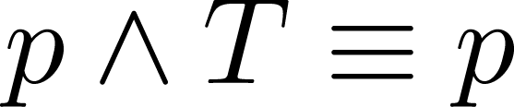
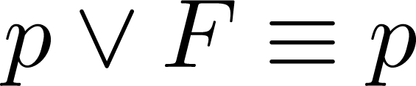
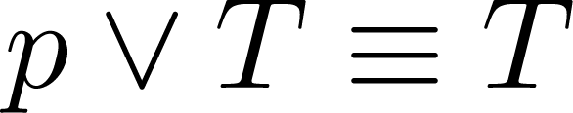
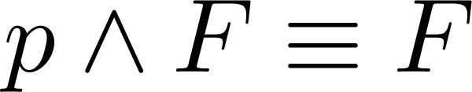
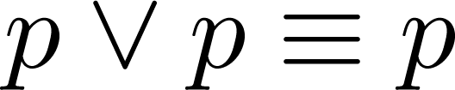
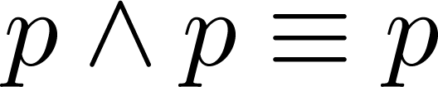
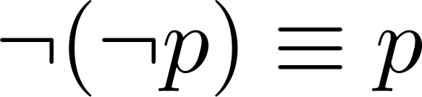
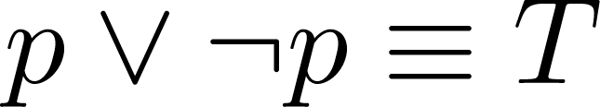
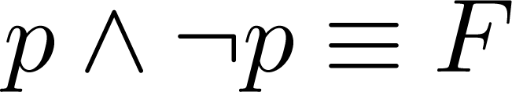
Key Logical Equivalences
Identity Laws: ,
Domination Laws: ,
Idempotent laws: ,
Double Negation Law:
Negation Laws: ,

Slide 34
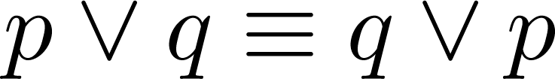
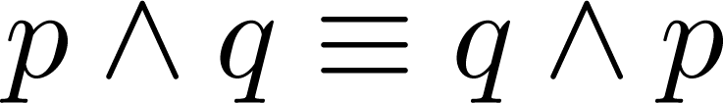
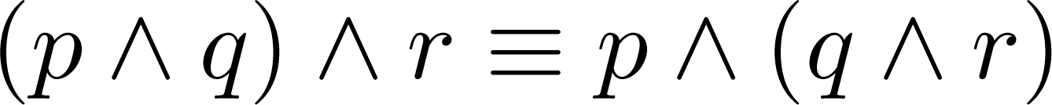
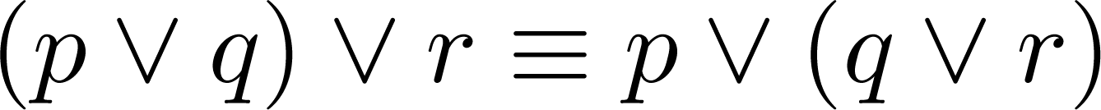
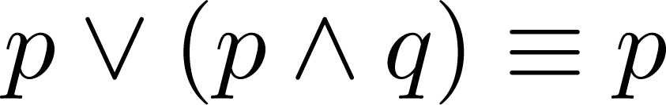
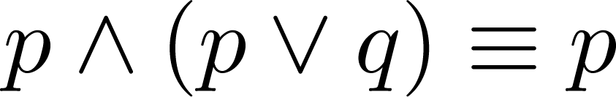
Key Logical Equivalences (cont)
Commutative Laws: ,
Associative Laws:
Distributive Laws:
Absorption Laws:

Slide 35
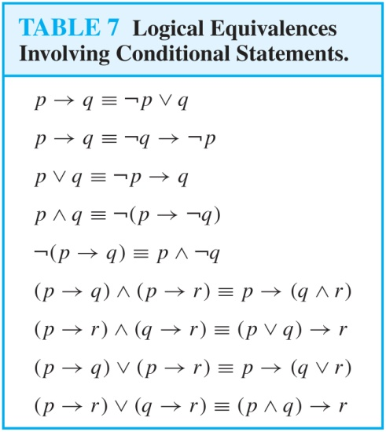
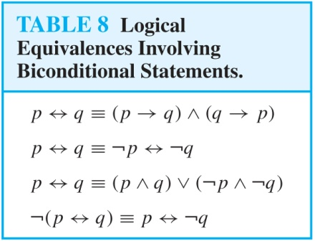
More Logical Equivalences

Slide 36
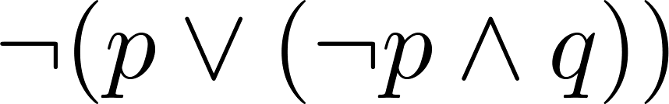
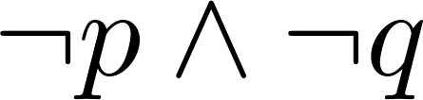
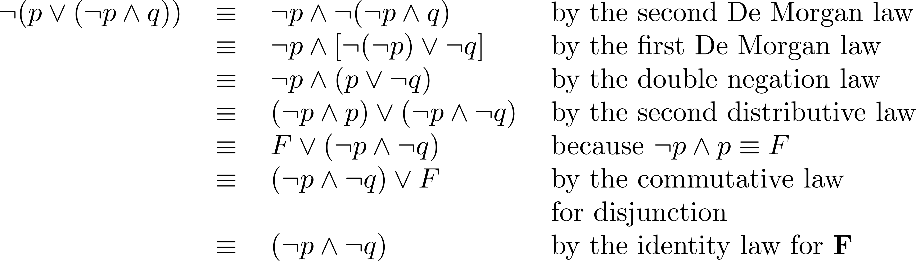
Equivalence Proofs
Example: Show that
is logically equivalent to
Solution:

Slide 37
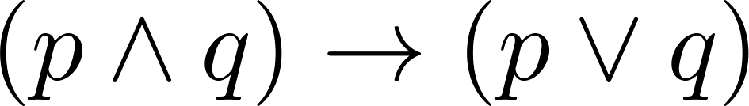
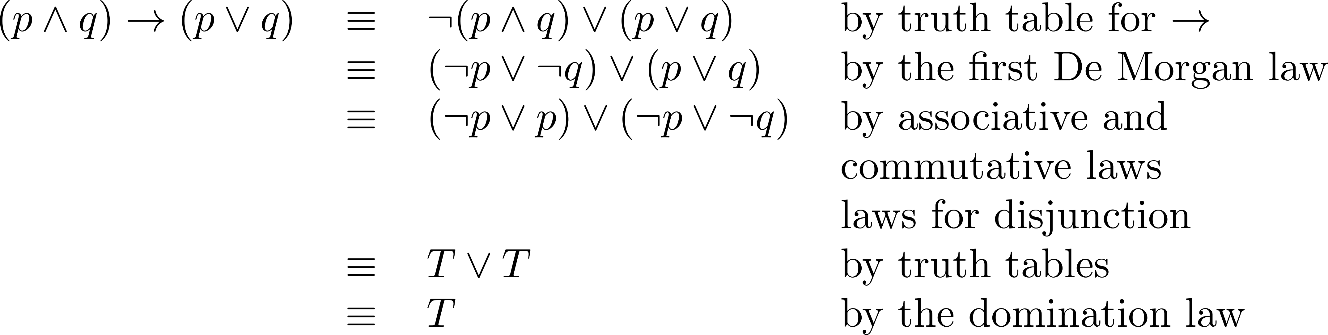
Equivalence Proofs
Example: Show that
is a tautology.
Solution:

Slide 38
Section Summary
Tautologies, Contradictions, and Contingencies.
Logical Equivalence
  Important Logical Equivalences
  Showing Logical Equivalence

