Slide 1
Sets and Set Operations

Slide 2
Chapter Summary
Sets
  The Language of Sets
  Set Operations
  Set Identities

Slide 3
Sets
Section 2.1

Slide 4
Section Summary
Definition of sets
Describing Sets
  Roster Method
  Set-Builder Notation
Some Important Sets in Mathematics
Empty Set and Universal Set
Subsets and Set Equality
Cardinality of Sets

Slide 5
Introduction
Sets are one of the basic building blocks for the types of objects considered in discrete mathematics.
  Important for counting.
  Programming languages have set operations.
Set theory is an important branch of mathematics.
  Many different systems of axioms have been used to develop set theory.
  Here we are not concerned with a formal set of axioms for set theory. Instead, we will use what is called naïve set theory.

Slide 6
Sets
A set is an unordered collection of well defined objects.
  the students in this class
  the chairs in this room
The objects in a set are called the elements, or members of the set. A set is said to contain its elements.
The notation a ∈ A denotes that a is an element of the set A.
If a is not a member of A, write a ∉ A

Slide 7
Describing a Set: Roster Method
S = {a, b, c, d}
Order not important
S = {a, b, c, d} = {b, c, a, d}
Each distinct object is either a member or not; listing more than once does not change the set.
S = {a, b, c, d} = {a, b, c, b, c, d}
Elipses (…) may be used to describe a set without listing all of the members when the pattern is clear.
S = {a, b, c, d, ……, z }

Slide 8
Roster Method
Set of all vowels in the English alphabet:
V = {a, e, i, o, u}
Set of all odd positive integers less than 10:
O = {1, 3, 5, 7, 9}
Set of all positive integers less than 100:
S = {1, 2, 3,…….., 99}
Set of all integers less than 0:
S = {…., -3, -2, -1}

Slide 9
Some Important Sets
N = natural numbers = {1, 2, 3….}
W = whole numbers = {0, 1, 2, 3….}
Z = integers = {…,-3, -2, -1, 0, 1, 2, 3,…}
Z⁺ = positive integers = {1, 2, 3,…..}
R = set of real numbers
R⁺ = set of positive real numbers
C = set of complex numbers.
Q = set of rational numbers

Slide 10
Set-Builder Notation
Specify the property or properties that all members must satisfy:
S = {x | x is a positive integer less than 100}
O = {x | x is an odd positive integer less than 10}
O = {x ∈ Z⁺ | x is odd and x < 10}
A predicate may be used:
S = {x | P(x)}
Example: S = {x | Prime(x)}
Positive rational numbers:
Q⁺ = {x ∈ R | x = p/q, for some positive integers
p, q }

Slide 11
Interval Notation
[a, b] = {x | a ≤ x ≤ b}
[a, b) = {x | a ≤ x < b}
(a, b] = {x | a < x ≤ b}
(a, b) = {x | a < x < b}
closed interval [a, b]
open interval (a, b)

Slide 12
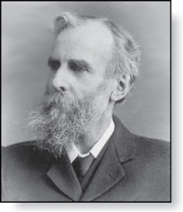
Universal Set and Empty Set
The universal set U is the set containing everything currently under consideration.
  Sometimes implicit
  Sometimes explicitly stated.
  Contents depend on the context.
The empty set is the set with no
elements. Symbolized ∅, but
{} also used.
Venn Diagram
U
V
a e i
o u
John Venn (1834-1923)
Cambridge, UK

Slide 13
Some things to remember
Sets can be elements of sets.
{{1, 2, 3},a, {b, c}}
{N, Z, Q, R}
The empty set is different from a set containing the empty set.
∅ ≠ { ∅ }

Slide 14
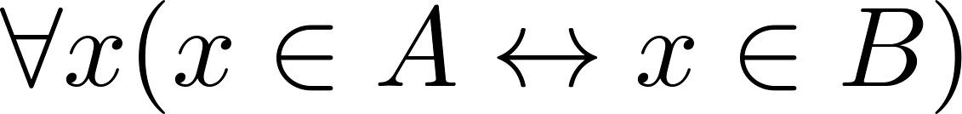
Set Equality
Definition: Two sets are equal if and only if they have the same elements.
  Therefore if A and B are sets, then A and B are equal if and only if .
  We write A = B if A and B are equal sets.
{1, 3, 5} = {3, 5, 1}
{1, 5, 5, 5, 3, 3, 1} = {1, 3, 5}

Slide 15
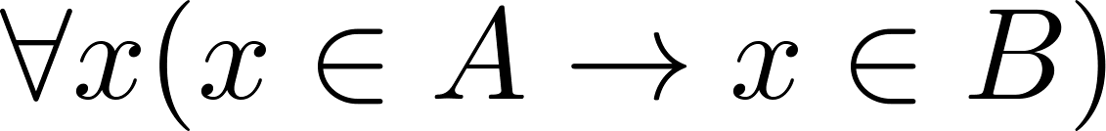
Subsets
Definition: The set A is a subset of B, if and only if every element of A is also an element of B.
  The notation A ⊆ B is used to indicate that A is a subset of the set B.
  A ⊆ B holds if and only if is true.
    ∅ ⊆ S ,for every set S.
    Because a ∈ S → a ∈ S, S ⊆ S, for every set S.

Slide 16
Showing a Set is or is not a Subset of Another Set
Showing that A is a Subset of B: To show that A ⊆ B, show that if x belongs to A, then x also belongs to B.
Showing that A is not a Subset of B: To show that A is not a subset of B, A ⊈ B, find an element x ∈ A with x ∉ B. (Such an x is a counterexample to the claim that x ∈ A implies x ∈ B.)
Examples:
  The set of all computer science majors at your school is a subset of all students at your school.
  The set of integers with squares less than 100 is not a subset of the set of nonnegative integers.

Slide 17
Another look at Equality of Sets
Recall that two sets A and B are equal, denoted by A = B, iff
Using logical equivalences we have that A = B iff
This is equivalent to
A ⊆ B and B ⊆ A

Slide 18
Proper Subsets
Definition: If A ⊆ B, but A ≠B, then we say A is a proper subset of B, denoted by A ⊂ B. If A ⊂ B, then
is true.
Venn Diagram
U
B
A

Slide 19
Set Cardinality
Definition: If there are exactly n distinct elements in S where n is a nonnegative integer, we say that S is finite. Otherwise it is infinite.
Definition: The cardinality of a finite set A, denoted by |A|, is the number of (distinct) elements of A.
Examples:
|ø| = 0
Let S be the letters of the English alphabet. Then |S| = 26
|{1,2,3}| = 3
|{ø}| = 1
The set of integers is infinite.

Slide 20
Power Sets
Definition: The set of all subsets of a set A, denoted P(A), is called the power set of A.
Example: If A = {a, b} then
P(A) = {ø, {a},{b},{a, b}}
If a set has n elements, then the cardinality of the power set is 2ⁿ. (In Chapters 5 and 6, we will discuss different ways to show this.)

Slide 21
Section Summary
Definition of sets
Describing Sets
  Roster Method
  Set-Builder Notation
Some Important Sets in Mathematics
Empty Set and Universal Set
Subsets and Set Equality
Cardinality of Sets

Slide 22
Set Operations
Section 2.2

Slide 23
Section Summary
Set Operations
  Union
  Intersection
  Complementation
  Difference
Set Identities
Proving Identities

Slide 24
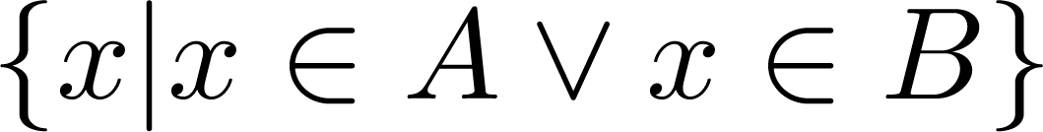
Union
Definition: Let A and B be sets. The union of the sets A and B, denoted by A ∪ B, is the set:
Example: What is {1,2,3} ∪ {3, 4, 5}?
Solution: {1,2,3,4,5}
Venn Diagram for A ∪ B
U
A
B

Slide 25
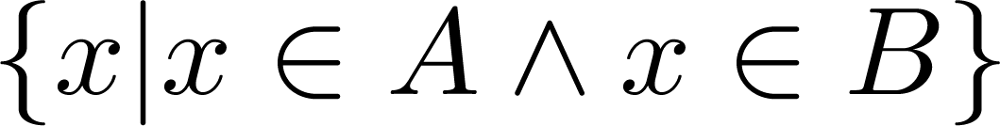
Intersection
Definition: The intersection of sets A and B, denoted by A ∩ B, is
Note if the intersection is empty, then A and B are said to be disjoint.
Example: What is {1,2,3} ∩ {3,4,5} ?
Solution: {3}
Example: What is?
{1,2,3} ∩ {4,5,6} ?
Solution: ∅
Venn Diagram for A ∩B
U
A
B

Slide 26
Complement
Definition: If A is a set, then the complement of the A (with respect to U), denoted by Ā is the set U - A
Ā = {x ∈ U | x ∉ A}
(The complement of A is sometimes denoted by A^{c} .)
Example: If U is the positive integers less than 100, what is the complement of {x | x > 70}
Solution: {x | x ≤ 70}
Venn Diagram for Complement
U
Ā
A

Slide 27
Difference
Definition: Let A and B be sets. The difference of A and B, denoted by A – B, is the set containing the elements of A that are not in B. The difference of A and B is also called the complement of B with respect to A.
A – B = {x | x ∈ A ∧ x ∉ B} = A ∩‾B
U
Venn Diagram for A − B
A
B

Slide 28

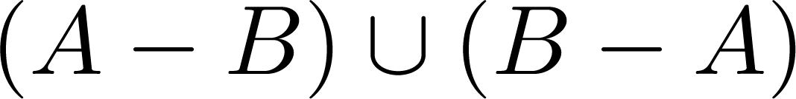
Symmetric Difference
Definition: The symmetric difference of A and B, denoted by is the set
Example:
  U = {0,1,2,3,4,5,6,7,8,9,10}
  A = {1,2,3,4,5} B ={4,5,6,7,8}
  What is:
  Solution: {1,2,3,6,7,8}
U
A
B
Venn Diagram

Slide 29
Review Questions
Example: U = {0,1,2,3,4,5,6,7,8,9,10} A = {1,2,3,4,5}, B ={4,5,6,7,8}
  A ∪ B
    Solution: {1,2,3,4,5,6,7,8}
  A ∩ B
    Solution: {4,5}
  Ā
    Solution: {0,6,7,8,9,10}
    Solution: {0,1,2,3,9,10}
  A – B
    Solution: {1,2,3}
  B – A
    Solution: {6,7,8}

Slide 30



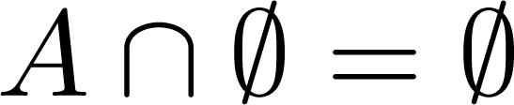


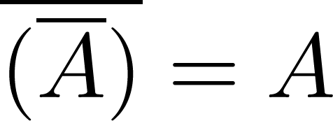
Set Identities
Identity laws
Domination laws
Idempotent laws
Complementation law
Continued on next slide →

Slide 31


Set Identities
Commutative laws
Associative laws
Distributive laws
Continued on next slide →

Slide 32


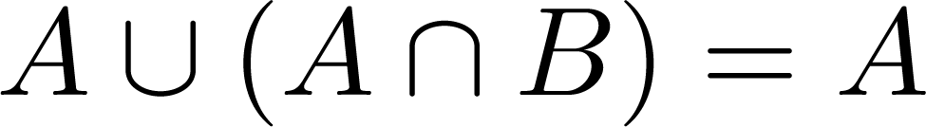
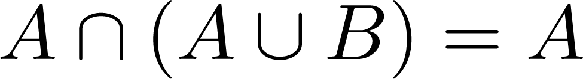

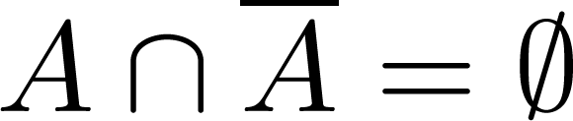
Set Identities
De Morgan’s laws
Absorption laws
Complement laws

Slide 33
Proving Set Identities
Different ways to prove set identities:
  Prove that each set (side of the identity) is a subset of the other.
  Use set builder notation and propositional logic.
  Membership Tables: Verify that elements in the same combination of sets always either belong or do not belong to the same side of the identity. Use 1 to indicate it is in the set and a 0 to indicate that it is not.

Slide 34
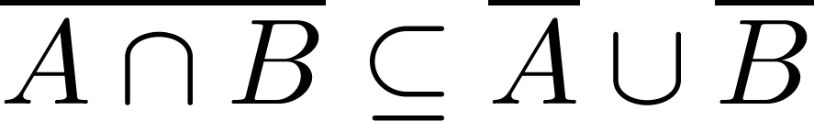

Proof of Second De Morgan Law
Example: Prove that
Solution: We prove this identity by showing that:
1) and
2)
Continued on next slide →

Slide 35
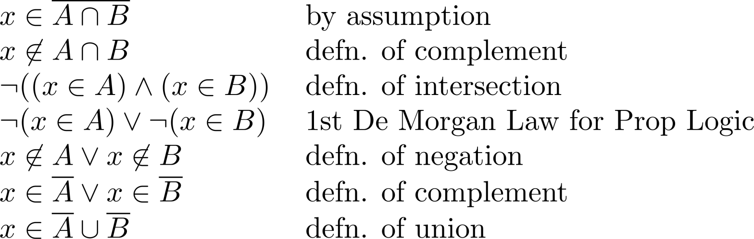
Proof of Second De Morgan Law
These steps show that:
Continued on next slide →

Slide 36
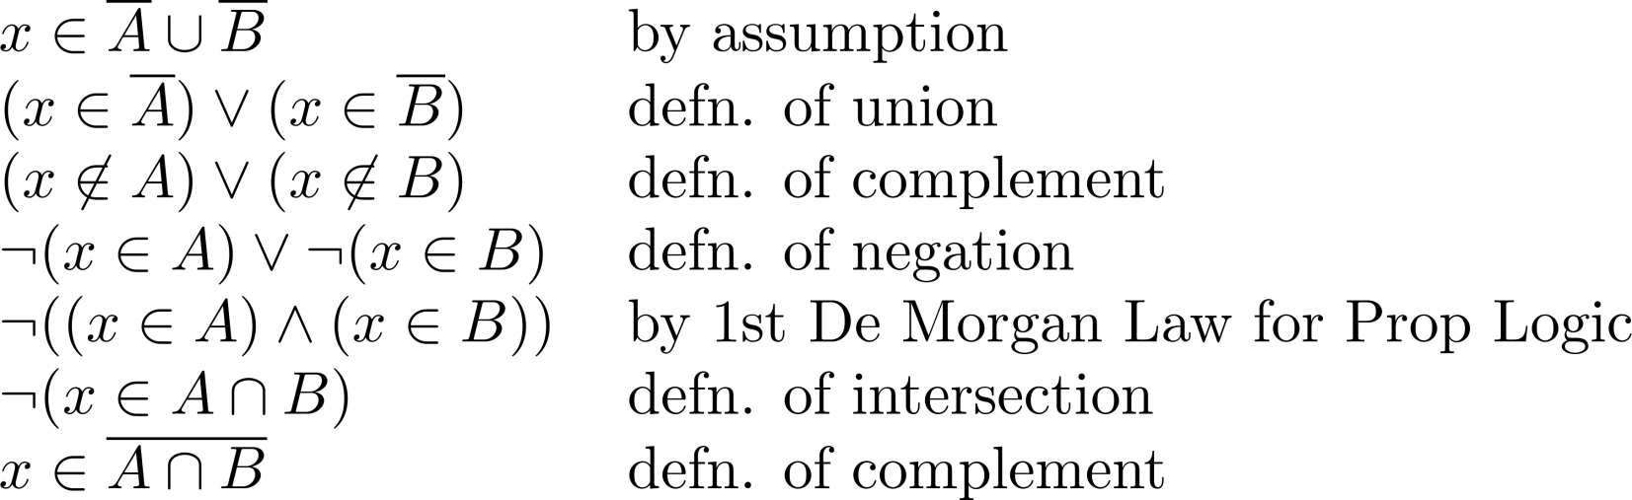
Proof of Second De Morgan Law
These steps show that:

Slide 37
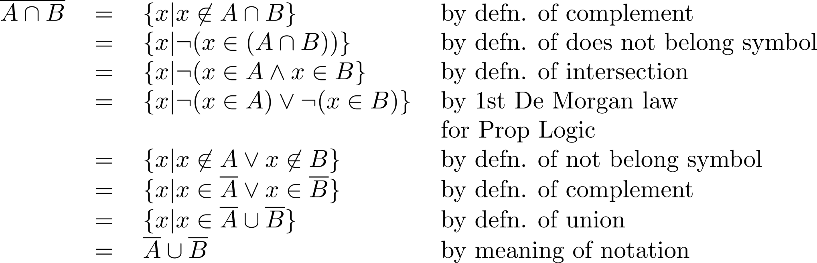
Set-Builder Notation: Second De Morgan Law

Slide 38
The Cardinality of the Union of Two Sets
Inclusion-Exclusion
|A ∪ B| = |A| + | B| - |A ∩ B|
Example: Let A be the math majors in your class and B be the CS majors. To count the number of students who are either math majors or CS majors, add the number of math majors and the number of CS majors, and subtract the number of joint CS/math majors.
U
A
B
Venn Diagram for A, B, A ∩ B, A ∪ B

