Slide 1
Inclusion-Exclusion
Section 8.5

Slide 2
Section Summary
The Principle of Inclusion-Exclusion
Examples

Slide 3
Principle of Inclusion-Exclusion
In Section 2.2, we developed the following formula for the number of elements in the union of two finite sets:
We will generalize this formula to finite sets of any size.

Slide 4
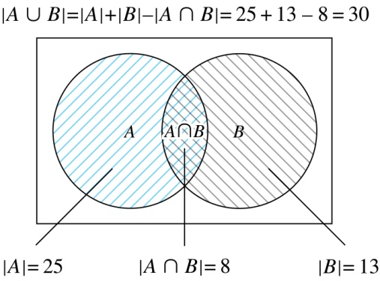
Two Finite Sets
Example: In a discrete mathematics class every student is a major in computer science or mathematics or both. The number of students having computer science as a major (possibly along with mathematics) is 25; the number of students having mathematics as a major (possibly along with computer science) is 13; and the number of students majoring in both computer science and mathematics is 8. How many students are in the class?
Solution: |A∪B| = |A| + |B| −|A∩B|
= 25 + 13 −8 = 30

Slide 5
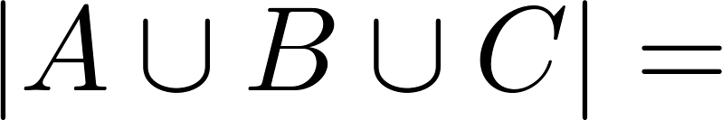
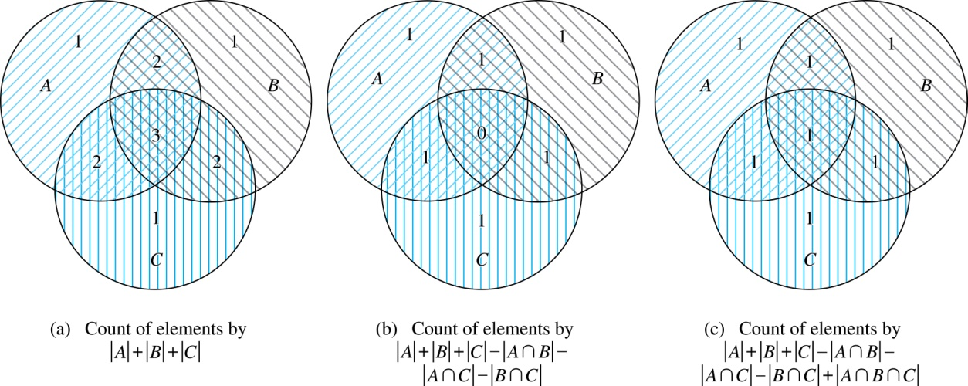
Three Finite Sets

Slide 6
Three Finite Sets Continued
Example: A total of 1232 students have taken a course in Spanish, 879 have taken a course in French, and 114 have taken a course in Russian. Further, 103 have taken courses in both Spanish and French, 23 have taken courses in both Spanish and Russian, and 14 have taken courses in both French and Russian. If 2092 students have taken a course in at least one of Spanish French and Russian, how many students have taken a course in all 3 languages.
Solution: Let S be the set of students who have taken a course in Spanish, F the set of students who have taken a course in French, and R the set of students who have taken a course in Russian. Then, we have
|S| = 1232, |F| = 879, |R| = 114, |S∩F| = 103, |S∩R| = 23, |F∩R| = 14, and |S∪F∪R| = 2092.
Using the equation
|S∪F∪R| = |S|+ |F|+ |R| − |S∩F| − |S∩R| − |F∩R| + |S∩F∩R|,
we obtain 2092 = 1232 + 879 + 114 −103 −23 −14 + |S∩F∩R|.
Solving for |S∩F∩R| yields 7.

Slide 7
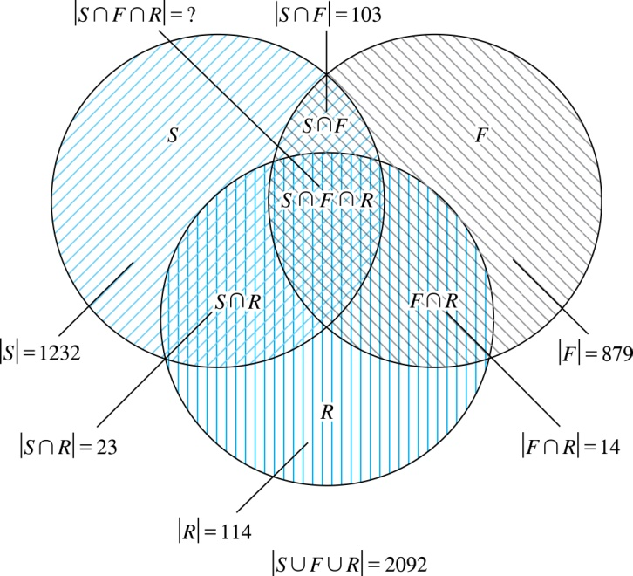
Illustration of Three Finite Set Example

Slide 8
Section Summary
The Principle of Inclusion-Exclusion
Examples

