Slide 1
Counting
Chapter 6
With Question/Answer Animations

Slide 2
Chapter Summary
The Product Rule
Permutations and Combinations

Slide 3
The Basics of Counting
Section 6.1

Slide 4
Basic Counting Principles: The Product Rule
The Product Rule: A procedure can be broken down into a sequence of two tasks. There are n₁ ways to do the first task and n₂ ways to do the second task. Then there are n₁∙n₂ ways to do the procedure.
Example: How many bit strings of length two are there?
Solution: Since each of the seven bits is either a 0 or a 1, the answer is 2² = 4.

Slide 5
Basic Counting Principles: The Product Rule
The Product Rule: A procedure can be broken down into a sequence of k tasks. There are
n₁ ways to do the first task;
n₂ ways to do the second task;
………………………………………
n_{k} ways to do the kth task.
Then there are n₁*n₂*……. *n_{k} ways to do the procedure.

Slide 6
Basic Counting Principles: The Product Rule
Example: How many bit strings of length seven are there?
Solution: Since each of the seven bits is either a 0 or a 1, the answer is 2⁷ = 128.

Slide 7
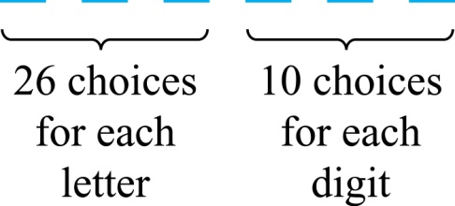
The Product Rule
Example: How many different license plates can be made if each plate contains a sequence of three uppercase English letters followed by three digits?
Solution: By the product rule,
there are 26 ∙ 26 ∙ 26 ∙ 10 ∙ 10 ∙ 10 = 17,576,000 different possible license plates.

Slide 8
Permutations and Combinations
Section 6.3

Slide 9
Section Summary
Permutations
Combinations

Slide 10
Permutations
Definition: A permutation of a set of distinct objects is an ordered arrangement of these objects. An ordered arrangement of r elements of a set is called an r-permutation.
Example: Let S = {1,2,3}.
  The ordered arrangement 3,1,2 is a permutation of S.
  The ordered arrangement 3,2 is a 2-permutation of S.
The number of r-permutations of a set with n elements is denoted by P(n, r).
  The 2-permutations of S = {1,2,3} are 1,2; 1,3; 2,1; 2,3; 3,1; and 3,2. Hence, P(3,2) = 6.

Slide 11
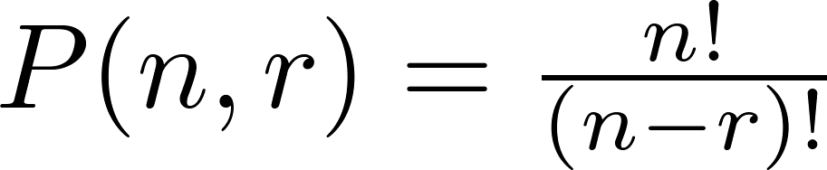
A Formula for the Number of Permutations
Theorem 1: If n is a positive integer and r is an integer with 1 ≤ r ≤ n, then there are
P(n, r) = n(n − 1)(n − 2) ∙∙∙ (n − r + 1)
r-permutations of a set with n distinct elements.
Proof: Use the product rule. The first element can be chosen in n ways. The second in n − 1 ways, and so on until there are (n − ( r − 1)) ways to choose the last element.
-Note that P(n,0) = 1, since there is only one way to order
zero elements.
-P(n, n) = n! = 1 x 2 x 3 x ……(n-2)x(n- 1)X n, read as n factorial.
Corollary 1: If n and r are integers with 1 ≤ r ≤ n, then

Slide 12
Solving Counting Problems by Counting Permutations
Example: How many ways are there to select a first-prize winner, a second prize winner, and a third-prize winner from 100 different people who have entered a contest?
Solution:
P(100,3) = 100 ∙ 99 ∙ 98 = 970,200

Slide 13
Solving Counting Problems by Counting Permutations (continued)
Example: Suppose that a saleswoman has to visit eight different cities. She must begin her trip in a specified city, but she can visit the other seven cities in any order she wishes. How many possible orders can the saleswoman use when visiting these cities?
Solution: The first city is chosen, and the rest are ordered arbitrarily. Hence the orders are:
7! = 7 ∙ 6 ∙ 5 ∙ 4 ∙ 3 ∙ 2 ∙ 1 = 5040
If she wants to find the tour with the shortest path that visits all the cities, she must consider 5040 paths!

Slide 14

Combinations
Definition: An r-combination of elements of a set is an unordered selection of r elements from the set. Thus, an r-combination is simply a subset of the set with r elements.
The number of r-combinations of a set with n distinct elements is denoted by C(n, r). The notation is also used and is called a binomial coefficient. (We will see the notation again in the binomial theorem in Section 6.4.)
Example: Let S be the set {a, b, c, d}. Then {a, c, d} is a 3-combination from S. It is the same as {d, c, a} since the order listed does not matter.
C(4,2) = 6 because the 2-combinations of {a, b, c, d} are the six subsets {a, b}, {a, c}, {a, d}, {b, c}, {b, d}, and {c, d}.

Slide 15
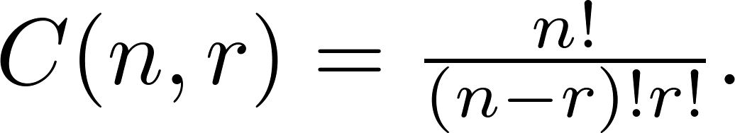
Combinations
Theorem 2: The number of r-combinations of a set with n elements, where n ≥ r ≥ 0, equals
Proof: By the product rule P(n, r) = C(n,r) ∙ P(r,r). Therefore,

Slide 16
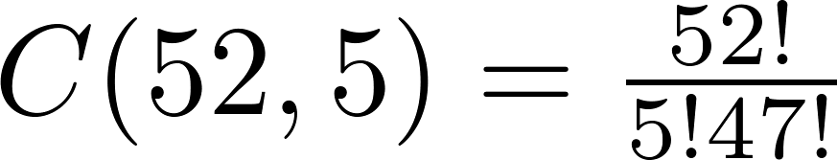
Combinations
Example: How many poker hands of five cards can be dealt from a standard deck of 52 cards? Also, how many ways are there to select 47 cards from a deck of 52 cards?
Solution: Since the order in which the cards are dealt does not matter, the number of five card hands is:
The different ways to select 47 cards from 52 is
This is a special case of a general result. →

Slide 17
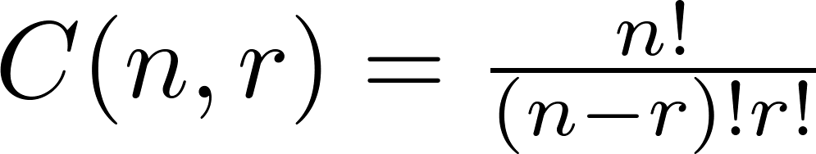
Combinations
Corollary 2: Let n and r be nonnegative integers with r ≤ n. Then C(n, r) = C(n, n − r).
Proof: From Theorem 2, it follows that
and
Hence, C(n, r) = C(n, n − r).
This result can be proved without using algebraic manipulation. →

Slide 18
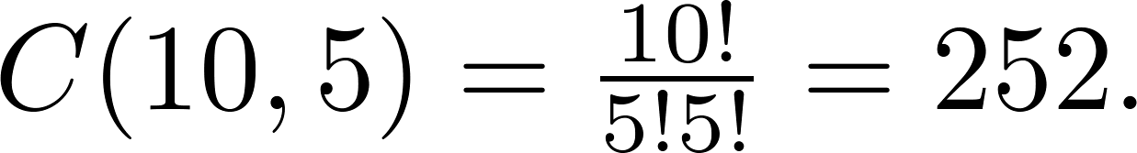
Combinations
Example: How many ways are there to select five players from a 10-member tennis team to make a trip to a match at another school.
Solution: By Theorem 2, the number of combinations is
Example: A group of 30 people have been trained as astronauts to go on the first mission to Mars. How many ways are there to select a crew of six people to go on this mission?
Solution: By Theorem 2, the number of possible crews is

Slide 19
How many bits strings of length n contain exactly r 1s?
The answer is C(n, r).

Slide 20
Combinatorial Proofs
Definition 1: A combinatorial proof of an identity is a proof that uses one of the following methods.
  A bijective proof shows that there is a bijection between the sets of objects counted by the two sides of the identity.

Slide 21

Combinatorial Proofs
Here are two combinatorial proofs that
C(n, r) = C(n, n − r)
when r and n are nonnegative integers with r < n:
  Bijective Proof: Suppose that S is a set with n elements. The function that maps a subset A of S to is a bijection between the subsets of S with r elements and the subsets with n − r elements. Since there is a bijection between the two sets, they must have the same number of elements.

