Slide 1
The Pigeonhole Principle
Section 6.2

Slide 2
Section Summary
The Pigeonhole Principle
The Generalized Pigeonhole Principle

Slide 3
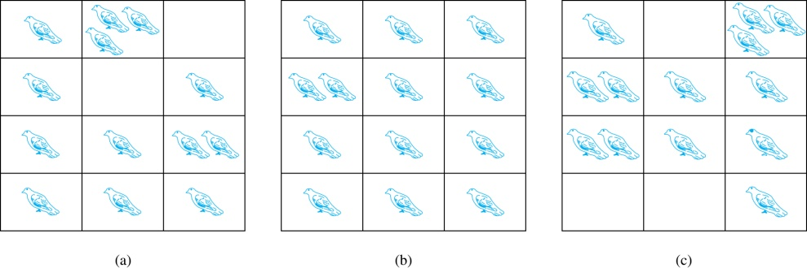
The Pigeonhole Principle
If a flock of 20 pigeons roosts in a set of 19 pigeonholes, one of the pigeonholes must have more than 1 pigeon.
Pigeonhole Principle: If k is a positive integer and k + 1 objects are placed into k boxes, then at least one box contains two or more objects.
Proof: We use a proof by contraposition. Suppose none of the k boxes has more than one object. Then the total number of objects would be at most k. This contradicts the statement that we have k + 1 objects.

Slide 4
Pigeonhole Principle
Example: Among any group of 367 people, there must be at least two with the same birthday, because there are only 366 possible birthdays.
Example: In any group of 27 English words, there must be at least two that begin with the same letter, because there are 26 letters in the English alphabet.

Slide 5
Pigeonhole Principle, An Example
Show that if any five integers from 1 to 8 are chosen, then two of them will add to 9.
Proof.
Pigeons: the five selected numbers.
Pigeonholes: {1, 8}, {2, 7}, {3, 6}, and {4, 5}.
Assignment rule: integer k will be assigned into the
set containing it.
By Pigeonhole principle, two of them will be in the same set
and their sum is 9.

Slide 6
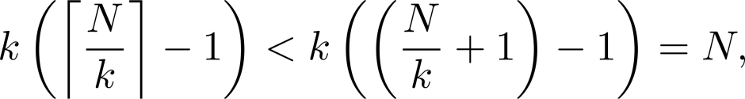
The Generalized Pigeonhole Principle
The Generalized Pigeonhole Principle: If N objects are placed into k boxes, then there is at least one box containing at least ⌈N/k⌉ objects.
Proof: We use a proof by contraposition. Suppose that none of the boxes contains more than ⌈N/k⌉ − 1 objects. Then the total number of objects is at most
where the inequality ⌈N/k⌉ < N/k + 1 has been used. This is a contradiction because there are a total of n objects.
Example: Among 100 people there are at least ⌈100/12⌉ = 9 who were born in the same month.

Slide 7
Pigeonhole Principle
Example: Among 100 people there are at least
the ceiling of 100/12 = 9 who were born in the same month.

