Slide 1
Number Theory
Chapter 4
With Question/Answer Animations

Slide 2
Divisibility
Section 4.1

Slide 3
Division Algorithm
When an integer is divided by a positive integer, there is a quotient and a remainder. This is traditionally called the “Division Algorithm,” but is really a theorem.
Division Algorithm: If a is an integer and d a positive integer, then there are unique integers q and r, with 0 ≤ r < d, such that a = dq + r (proved in Section 5.2).
    d is called the divisor.
    a is called the dividend.
    q is called the quotient.
    r is called the remainder.
Examples:
    What are the quotient and remainder when 101 is divided by 11?
    Solution: The quotient when 101 is divided by 11 is 9 = 101 div 11, and the remainder is 2 = 101 mod 11.
    What are the quotient and remainder when 12 is divided by 3?
    Solution: The quotient when 12 is divided by 3 is 4 = 12 div 3, and the remainder is 0 = 12 mod 3.
    What are the quotient and remainder when 17 is divided by 30?
    Solution: The quotient when 17 is divided by 30 is 0 = 17 div 30, and the remainder is 17 = 17 mod 30.
Definitions of Functions div and mod
  q = a div d
  r = a mod d

Slide 4
Division
Definition: If a and b are integers with a ≠ 0, then a divides b if there exists an integer c such that b = ac.
  When a divides b we say that a is a factor or divisor of b and that b is a multiple of a.
  The notation a | b denotes that a divides b.
  If a | b, then b/a is an integer.
  If a does not divide b, we write a ∤ b.
Example: Determine whether 3 | 7 and whether 3 | 12.

Slide 5
Properties of Divisibility
Theorem 1: Let a, b, and c be integers, where a ≠0.
  If a | b and a | c, then a | (b + c);
  If a | b, then a | bc for all integers c;
  If a | b and b | c, then a | c.
  Proof: (i) Suppose a | b and a | c, then it follows that there are integers s and t with b = as and c = at. Hence,
  b + c = as + at = a(s + t). Hence, a | (b + c)
(Exercises 3 and 4 ask for proofs of parts (ii) and (iii).) Corollary: If a, b, and c be integers, where a ≠0, such that a | b and a | c, then a | mb + nc whenever m and n are integers.
Can you show how it follows easily from from (ii) and (i) of Theorem 1?

Slide 6
Primes and Greatest Common Divisors
Section 4.3

Slide 7
Primes
Definition: A positive integer p greater than 1 is called prime if the only positive factors of p are 1 and p. A positive integer that is greater than 1 and is not prime is called composite.
Example: The integer 7 is prime because its only positive factors are 1 and 7, but 9 is composite because it is divisible by 3.

Slide 8
The Fundamental Theorem of Arithmetic
Theorem: Every positive integer greater than 1 can be written uniquely as a prime or as the product of two or more primes where the prime factors are written in order of nondecreasing size.
Examples:
  100 = 2 ∙ 2 ∙ 5 ∙ 5 = 2² ∙ 5²
  641 = 641
  999 = 3 ∙ 3 ∙ 3 ∙ 37 = 3³ ∙ 37
  1024 = 2 ∙ 2 ∙ 2 ∙ 2 ∙ 2 ∙ 2 ∙ 2 ∙ 2 ∙ 2 ∙ 2 = 2¹⁰

Slide 9
Greatest Common Divisor
Definition: Let a and b be integers, not both zero. The largest integer d such that d | a and also d | b is called the greatest common divisor of a and b. The greatest common divisor of a and b is denoted by gcd(a,b).
One can find greatest common divisors of small numbers by inspection.
Example: What is the greatest common divisor of 24 and 36?
Solution: gcd(24, 36) = 12
Example: What is the greatest common divisor of 17 and 22?
Solution: gcd(17, 22) = 1

Slide 10
Greatest Common Divisor
Definition: The integers a and b are relatively prime if their greatest common divisor is 1.
Example: 17 and 22
Definition: The integers a₁, a₂, …, a_{n} are pairwise relatively prime if gcd(a_{i}, a_{j})= 1 whenever 1 ≤ i<j ≤n.
Example: Determine whether the integers 10, 17 and 21 are pairwise relatively prime.
Solution: Because gcd(10,17) = 1, gcd(10,21) = 1, and gcd(17,21) = 1, 10, 17, and 21 are pairwise relatively prime.
Example: Determine whether the integers 10, 19, and 24 are pairwise relatively prime.
Solution: Because gcd(10,24) = 2, 10, 19, and 24 are not pairwise relatively prime.

Slide 11
Greatest Common Divisor
Definition: The integers a and b are relatively prime if their greatest common divisor is 1.
Example: 17 and 22
Definition: The integers a₁, a₂, …, a_{n} are pairwise relatively prime if gcd(a_{i}, a_{j})= 1 whenever 1 ≤ i<j ≤n.
Example: Determine whether the integers 10, 17 and 21 are pairwise relatively prime.
Solution: Because gcd(10,17) = 1, gcd(10,21) = 1, and gcd(17,21) = 1, 10, 17, and 21 are pairwise relatively prime.
Example: Determine whether the integers 10, 19, and 24 are pairwise relatively prime.
Solution: Because gcd(10,24) = 2, 10, 19, and 24 are not pairwise relatively prime.

Slide 12
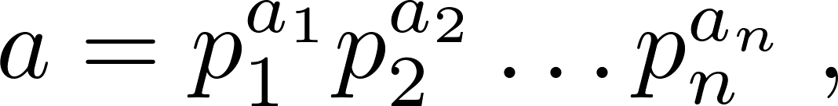
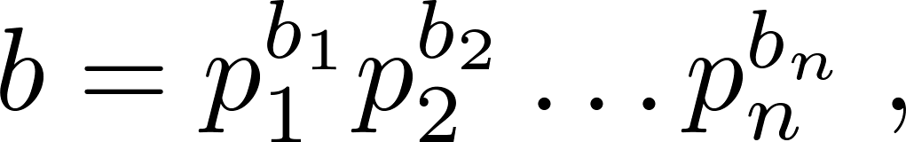
Finding the Greatest Common Divisor Using Prime Factorizations
Suppose the prime factorizations of a and b are:
where each exponent is a nonnegative integer, and where all primes occurring in either prime factorization are included in both. Then:
This formula is valid since the integer on the right (of the equals sign) divides both a and b. No larger integer can divide both a and b.
Example: 120 = 2³ ∙3 ∙5 500 = 2² ∙5³
gcd(120,500) = 2^{min(3,2)} ∙3^{min(1,0)} ∙5^{min(1,3)} = 2² ∙3⁰ ∙5¹ = 20
Finding the gcd of two positive integers using their prime factorizations is not efficient because there is no efficient algorithm for finding the prime factorization of a positive integer.

Slide 13
Finding the Greatest Common Divisor Using Prime Factorizations
Suppose the prime factorizations of a and b are:
where each exponent is a nonnegative integer, and where all primes occurring in either prime factorization are included in both. Then:
This formula is valid since the integer on the right (of the equals sign) divides both a and b. No larger integer can divide both a and b.
Example: 120 = 2³ ∙3 ∙5 500 = 2² ∙5³
gcd(120,500) = 2^{min(3,2)} ∙3^{min(1,0)} ∙5^{min(1,3)} = 2² ∙3⁰ ∙5¹ = 20
Finding the gcd of two positive integers using their prime factorizations is not efficient because there is no efficient algorithm for finding the prime factorization of a positive integer.

Slide 14
Least Common Multiple
Definition: The least common multiple of the positive integers a and b is the smallest positive integer that is divisible by both a and b. It is denoted by lcm(a,b).
The least common multiple can also be computed from the prime factorizations.
This number is divided by both a and b and no smaller number is divided by a and b.
Example: lcm(2³3⁵7², 2⁴3³) = 2^{max(3,4)} 3^{max(5,3)} 7^{max(2,0)} = 2⁴ 3⁵ 7²
The greatest common divisor and the least common multiple of two integers are related by:
Theorem 5: Let a and b be positive integers. Then
ab = gcd(a,b) ∙lcm(a,b)
(proof is Exercise 31)

Slide 15
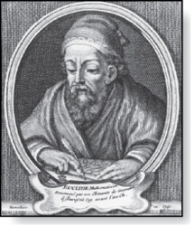
Euclidean Algorithm
Euclid
(325 B.C.E. – 265 B.C.E.)
The Euclidian algorithm is an efficient method for computing the greatest common divisor of two integers. It is based on the idea that gcd(a, b) is equal to gcd(a, c) when a > b and c is the remainder when a is divided by b.
Example: Find gcd(91, 287):
    287 = 91 ∙ 3 + 14
    91 = 14 ∙ 6 + 7
    14 = 7 ∙ 2 + 0
  gcd(287, 91) = gcd(91, 14) = gcd(14, 7) = 7
Divide 287 by 91
Divide 91 by 14
Divide 14 by 7
Stopping condition
continued →

Slide 16
Euclidean Algorithm
The Euclidean algorithm expressed in pseudocode is:
In Section 5.3, we’ll see that the time complexity of the algorithm is O(log b), where a > b.
procedure gcd(a, b: positive integers)
x := a
y := b
while y ≠ 0
r := x mod y
x := y
y := r
return x {gcd(a,b) is x}

