Slide 1
Matrices, Operations on Matrices and
An Application of Matrices

Slide 2
Outline
Definitions and Terminology on Matrices
Matrix Operations
The Applications of Matrices in Google’s PageRank Algorithm.

Slide 3
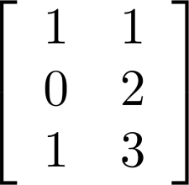
Matrix
Definition: A matrix is a rectangular array of numbers.
A matrix is often denoted by a capital letter.
The row number, denoted by r(M), of a matrix M is the number of
the row in the rectangular array.
The column number, denoted by c(M), of a matrix M is the
number of column in the rectangular array.
M = is a matrix.
r(M) = 3 and c(M) = 2.

Slide 4
Matrix
If M is a matrix with r(M) = r and c(M) = c, then M is called
a r x c matrix. Read r x c as r by c. Often, M is written as M_{rxc.}
M = is a 3 x 2 matrix.
We can write M as M_{3x2} to indicate that M has 3 rows
and 2 columns.

Slide 5
Additional Examples of Matrices
1 2 3
A = 4 5 6 is a matrix, r(A) = 3, c(A) = 3.
7 8 9
A is a 3 x 3 matrix.
If M is a matrix such that r(M) = c(M), then
M is called a square matrix.

Slide 6
Additional Examples of Matrices
B = 1 2 3 4 5 6 is a matrix,
r(B) = 1, c(B) = 6.
If M is a matrix such that r(M) = 1, then
M is called a row matrix.

Slide 7
Additional Examples of Matrices
1
2
D = 3 is a matrix,
4
5
r(D) = 5, c(D) = 1.
If M is a matrix such that c(M) = 1, then
M is called a column matrix.

Slide 8
Additional Examples of Matrices
X = 100 is a matrix,
r(X) = 1, c(X) = 1.
Remark: for each number, we can form a 1 x 1
matrix.

Slide 9
The (i, j)th element or entry in a matrix
1 2 3 10
A = A_{3x4} = 4 5 6 11
7 8 9 12
-The (i, j)th element, denoted by a_{ij}, is the element located at the intersection
between ith row and jth column, where 1 ≤ i ≤ r(A) and 1 ≤ j ≤ c(A).
a₁₁ = 1, a₁₂ = 2, a₁₃ = 3, a₁₄ = 10,
a₂₁ = 4, a₂₂ = 5, a₂₃ = 6, a₂₄ = 11,
a₃₁ = 7, a₃₂ = 8, a₃₃ = 9, a₃₄ = 12.
-In this case, we can write A = A_{3x4} = (a_{ij})_{3x4.}

Slide 10
The ith row and jth column in a matrix
1 2 3 10
A = A_{3x4} = 4 5 6 11
7 8 9 12
-In A, the 1st row is [a₁₁, a₁₂, a₁₃, a₁₄],
the 2nd row is [a₂₁, a₂₂, a₂₃, a₂₄],
the 3rd row is [a₃₁, a₃₂, a₃₃, a₃₄].
-In general, the ith row in A = A_{3x4} = (a_{ij})_{3x4} is [a_{i1}, a_{i2}, a_{i3}, a_{i4}].

Slide 11
The ith row and jth column in a matrix
1 2 3 10
A = A_{3x4} = 4 5 6 11
7 8 9 12
-In A, the 1st column is the 2nd column is the 3rd column is the 4th column is
a₁₁ a₁₂ a₁₃ a₁₄
a₂₁ a₂₂ a₂₃ a₂₄
a₃₁ a₃₂ a₃₃ a₃₄

Slide 12
The ith row and jth column in a matrix
1 2 3 10
A = A_{3x4} = 4 5 6 11
7 8 9 12
-In general, the j^{th} column is
a_{1j}
a_{2j}
a_{3j}

Slide 13
Two Matrices Are Equal
-Two matrices A and B are equal if r(A) = r(B), c(A)
=c(B), and all the corresponding entries are equal.
-Suppose two matrices A and B are equal. Find x, y, and z
x - y 3x 10 y + z
A = 50 x + y , B = 50 30
40 2021 40 2021
-[Solutions] Since A and B are equal, we have
x – y = 10, x + y =30, and 3x = y + z.

Slide 14
Two Matrices Are Equal
-Suppose two matrices A and B are equal. Find x, y, and z
x - y 3x 10 y + z
A = 50 x + y , B = 50 30
40 2021 40 2021
-[Solutions] Since A and B are equal, we have
x – y = 10, x + y =30, and 3x = y + z. Thus
x – y + x + y = 10 + 30. Namely, 2x = 40, and x = 20.
Thus y = 30 – x = 30 – 20 = 10.
Hence z = 3x – y = 3*20 – 10 = 50.

Slide 15
Two Matrices Are Equal
-You can work a similar one below after today’s lecture.
-Suppose two matrices A and B are equal. Find x, y, and z
2x - y 70 10 70
A = 5y x + 2y , B = 2x + z 30
60 2022 60 2022

Slide 16
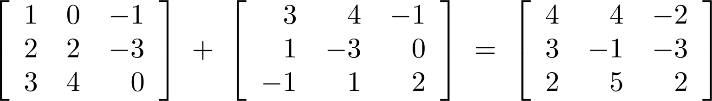
The Sum or Addition of Two Matrices
Definition: Let A = [a_{ij}] and B = [b_{ij}] be two m x n matrices. The sum of A and B, denoted by A + B, is the
m x n matrix such that a_{ij} + b_{ij} is its (i, j)th element. In other words, A + B = [a_{ij} + b_{ij}].
Example:
The requirements for computing the sum of A and B are
r(A) = r(B) and c(A) = c(B), otherwise A + B is not defined.

Slide 17
The Sum or Addition of Two Matrices
-For any two matrices A and B, if r(A) = r(B) and c(A) = c(B),
then A + B = B + A.
Namely, the matrix addition is commutative.
-For any three matrices A, B and D, if r(A) = r(B) = r(D) and
c(A) = c(B) = c(D), then (A + B) + D = A + (B + D).
Namely, the matrix addition is associative.

Slide 18
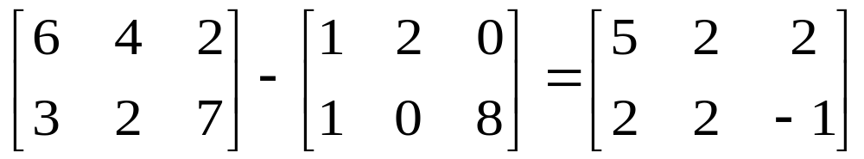
The Difference between Two Matrices
Definition: Let A = [a_{ij}] and B = [b_{ij}] be two m x n
matrices. The difference of A and B, denoted by A - B, is the
m x n matrix such that a_{ij} - b_{ij} is its (i, j)th element. In other
words, A - B = [a_{ij} - b_{ij}].
Example:
The requirements for computing the difference between A and
B are r(A) = r(B) and c(A) = c(B), otherwise A - B is not defined.

Slide 19
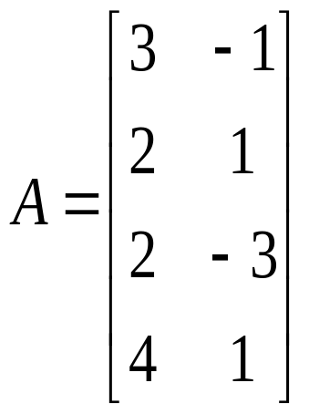
The Multiplication between a Number and a Matrix
A matrix can be multiplied by a number. Let k be a number and
A = (a_{ij}) is a matrix. Then
kA = Ak is defined as (ka_{ij}) = (a_{ij}k)
Example, If k = 4 and

Slide 20
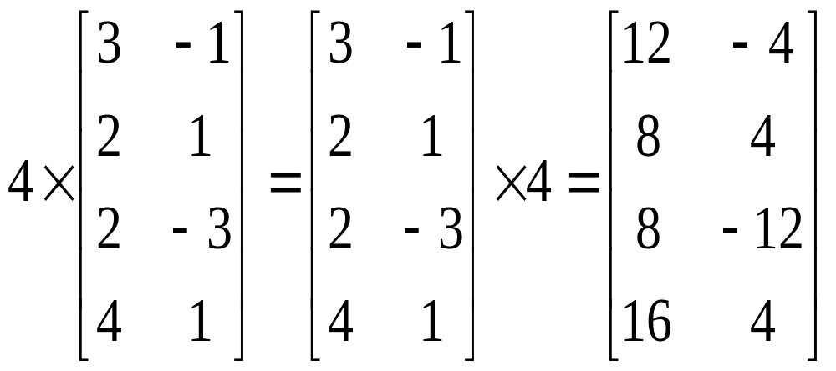
The Multiplication between a Number and a Matrix

Slide 21
An Example for Mixed Operations on Matrices
Suppose
1 2 -3 3 0 4
A = 4 5 , B = -2 -1 , and D = 5 6
0 -1 2 4 7 4
Then 3A + 2B – 4D =
3*1 3*2 2*(-3) 2*3 4*0 4*4 -3 -4
3*4 3*5 + 2*(-2) 2*(-1) - 4*5 4*6 = -12 -11
3*0 3*(-1) 2*2 2*4 4*7 4*4 -24 -11

Slide 22
You can work on a similar one after today’s lecture
Suppose
-1 4 -4 5 4 0
A = 3 -2 , B = 8 -6 , and D = 3 9
4 5 -3 2 8 2
Find 2A + 3B – 5D =

Slide 23
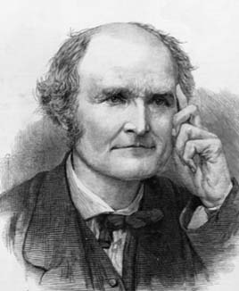
The Multiplication of Two Matrices
-The following definition for the multiplications for two
matrices was formally introduced by Arthur Cayley, a British mathematician.
-http://bellomo.faculty.unlv.edu/Math365/Notes/Ch1-Sect05_MatrixMultip.pdf
-https://en.wikipedia.org/wiki/Arthur_Cayley.
Arthur Cayley (1821-1895)

Slide 24
The Multiplication of Two Matrices
-The multiplication of a row matrix and a column matrix.
Suppose X is a row matrix and Y is a column matrix
such that c(X) = r(Y). For instance, c(X) = r(Y) = 5.
y₁
y₂
X = [x₁, x₂, x₃, x_{4,} x₅], Y = y_{3 .} Then XY = x₁y₁+ x₂y₂+ x₃y₃+ x₄y₄+ x₅y_{5.}
y₄
y₅

Slide 25
An Example for the Multiplication of Two Matrices
-When c(A) = r(B), we can multiply A and B, otherwise
AB is not defined.
-Suppose A is a 2x3 matrix and B is a 3x4 matrix.
7 8 9 0
A_{2x3} = 1 2 3 , B_{3x4} = -1 -2 -3 -4
4 5 6 -5 -6 -7 -8
Define M = A_{2x3} B_{3x4}. Then M has 2 rows and 4 columns.
Namely, M = M_{2x4} = (m_{ij})_{2x4.}

Slide 26
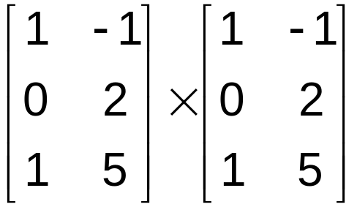
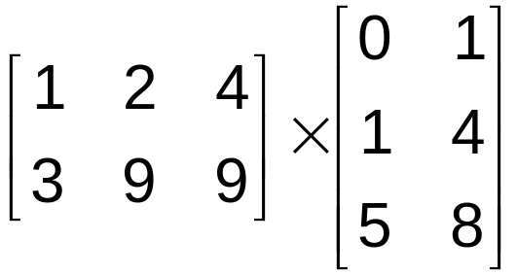
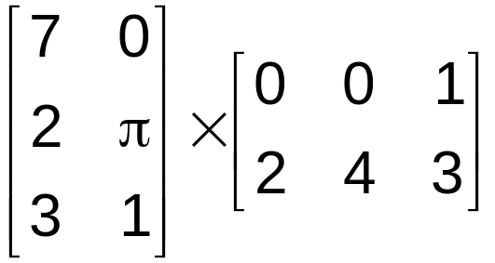
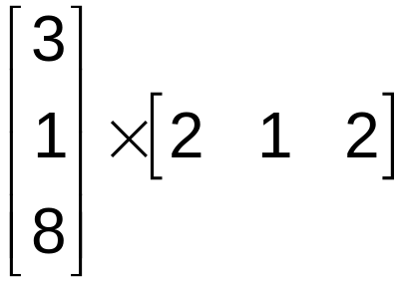
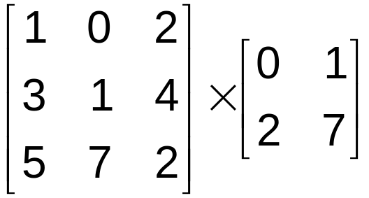
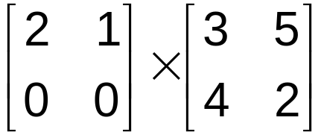
Are the following matrix multiplications possible?
NO
YES
3 x 2 3 x 2
2 x 3 3 x 2
YES
YES
3 x 2 2 x 3
3 x 1 1 x 3
YES
NO
2 x 2 2 x 2
3 x 3 2 x 2

Slide 27
An Example for the Multiplication of Two Matrices
-Now A is a 2x3 matrix and B is a 3x4 matrix.
A_{2x3} B_{3x4} = 1 2 3 7 8 9 0
4 5 6 -1 -2 -3 -4
-5 -6 -7 -8
1*7 + 2*(-1) + 3*(-5) 1*8 + 2*(-2) + 3*(-6) 1*9 + 2*(-3) + 3*(-7) 1*0 + 2*(-4) + 3*(-8)
= 4*7 + 5*(-1) + 6*(-5) 4*8 + 5*(-2) + 6*(-6) 4*9 + 5*(-3) + 6*(-7) 4*0 + 5*(-4) + 6*(-8) _{2x4}
-10 -14 -18 -32
=
-7 -14 -21 -68 _{2x4}
Use the ith row in the left matrix to multiply the jth column in the right matrix to obtain the (i, j)th m_{ij}
in M = AB, where 1 ≤ i ≤ r(A) and 1 ≤ j ≤ c(B).

Slide 28
An Example for the Multiplication of Two Matrices
-Another scheme for computing A_{2x3} B_{3x4} .
A_{2x3}= 1 2 3 m₁₁ m₁₂ m₁₃ m₁₄
4 5 6 m₂₁ m₂₂ m₂₃ m₂₄
7 8 9 0
B_{3x4} = -1 -2 -3 -4
-5 -6 -7 -8
m₁₁=1*7 + 2*(-1) + 3*(-5), m₁₂ =1*8 + 2*(-2) + 3*(-6), m₁₃ =1*9 + 2*(-3) + 3*(-7), m₁₄ =1*0 + 2*(-4) + 3*(-8)
m₂₁= 4*7 + 5*(-1) + 6*(-5), m₂₁=4*8 + 5*(-2) + 6*(-6), m₂₃=4*9 + 5*(-3) + 6*(-7), m₂₄ =4*0 + 5*(-4) + 6*(-8)
-10 -14 -18 -32
=
-7 -14 -21 -68 _{2x4}
Use the ith row in the left matrix to multiply the jth column in the right matrix to obtain the (i, j)th m_{ij}
in M = AB, where 1 ≤ i ≤ r(A) and 1 ≤ j ≤ c(B).

Slide 29
Multiplication of Two Matrices
Two matrices can be multiplied together only when
the number of columns in the left matrix on the
equals the number of rows in the right matrix.
A_{mxk}B_{kxn} = C_{mxn}

Slide 30
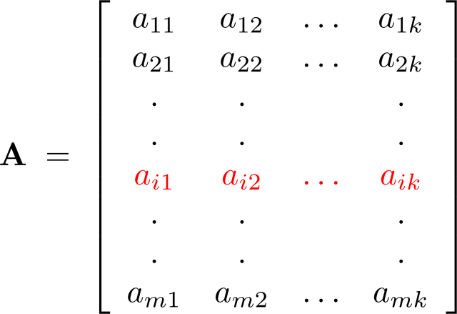
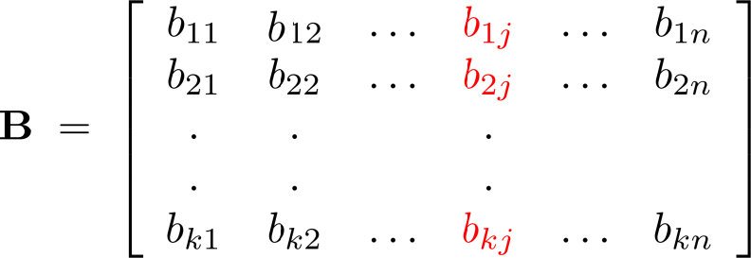
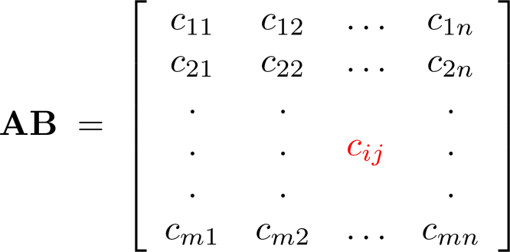
Illustrations of Matrix Multiplication
The Multiplication of A_{mxk} = [a_{ij}]_{mxk} and B_{kxn} = [b_{ij}]_{kxn}

Slide 31
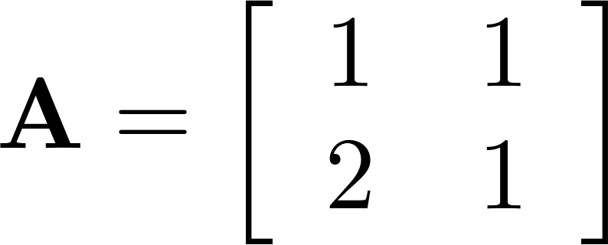
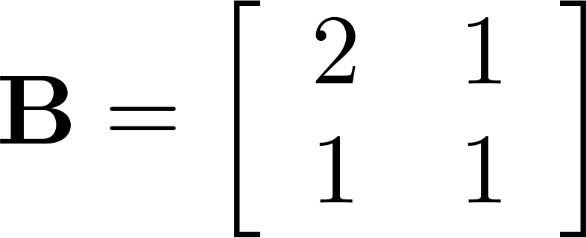
Matrix Multiplication Is Not Commutative
Let
Then
1 1 2 1 3 2
AB = =
2 1 1 1 5 3
2 1 1 1 4 3
BA = =
1 1 2 1 3 2
AB ≠ BA

Slide 32
The Applications of Matrices
-Matrices have applications in a lot of fields: Math, Computer Science, Statistics, Engineering, and etc..
-The Applications of matrices can be found in PageRank
algorithm.
-PageRank algorithm is used by Google to rank web pages.

Slide 33
The PageRank Algorithm
-The basic ideas of PageRank algorithm were described in a
paper entitled
“The PageRank Citation Ranking : Bringing Order to the Web”
-The paper was authored by Lawrence Page, Sergey Brin,
Rajeev Motwani, Terry Winograd.
-http://ilpubs.stanford.edu:8090/422/1/1999-66.pdf

Slide 34


The PageRank Algorithm
-The first two authors are the co-founders of Google.

Slide 35
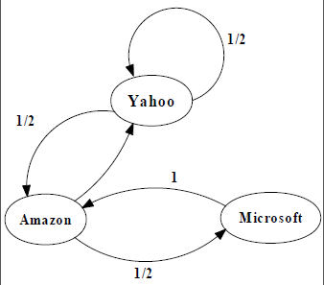
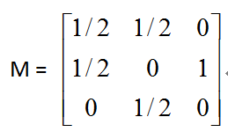
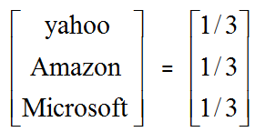
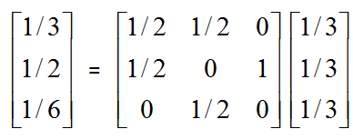
The Basic Ideas for PageRank Algorithm
PageRank Calculation: first iteration

Slide 36
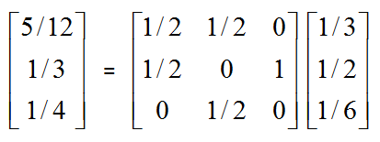
The Basic Ideas for PageRank Algorithm
PageRank Calculation: second iteration

Slide 37
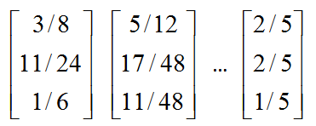
The Basic Ideas of PageRank Algorithm
Convergence after some iterations

Slide 38
Summary
Definitions and Terminology on Matrices
-Matrix M, row number of M, column number of M,
-Square matrix, row matrix, column matrix,
-ith row and jth column of a matrix,
-(i, j)th element or entry of M,
-Two matrices are equal.
Matrix Operations
-Sum of two matrices,
-Difference of two matrices,
-Multiplication of a number and a matrix
-Multiplication of two matrices.

Slide 39
Summary
-Multiplication of two matrices
A_{mxk} B_{kxn} = C_{mxn} = (c_{ij})_{mxn.}
c_{ij} = the multiplication of
the i^{th} row of A and
the j^{th} column of B.

Slide 40
Summary
-The applications of matrices in Google’s
PageRank algorithm.

Slide 41
Commutative Operators
-We say an operator, denoted by @, is commutative if
x @ y = y @ x is true for any two elements x and y.
-The addition operator “+” for two numbers is commutative
since x + y = y + x is true for any two numbers x and y.
-The multiplication operator “+” for two numbers is commutative since x + y = y + x is true for any two numbers
x and y.

Slide 42
Matrix Multiplication Is NOT Commutative
-A_{3x2} is a 3x2 matrix and B_{2x4} is a 2x4 matrix.
We can multiply A_{3x2} and B_{2x4}. Namely, A_{3x2} B_{2x4} is
well-defined. But we cannot multiply B_{2x4} and A_{3x2.}
-A_{3x2} is a 3x2 matrix and B_{2x3} is a 2x3 matrix.
We can multiply A_{3x2} and B_{2x3}. We can also multiply B_{2x3}
and A_{3x2.} But A_{3x2} B_{2x3} is a 3x3 matrix, B_{2x3}A_{3x2} is a 2x2
matrix. So A_{3x2} B_{2x3} ≠ B_{2x3}A_{3x2.}

Slide 43
Matrix Multiplication Is NOT Commutative
      5 2
      A = 7 4 and B = 9 2 4
        3 1 -2 3 6
      41 16 32
      then AB = 55 52 52 and BA = 71 30
      25 9 18 29 14

Slide 44

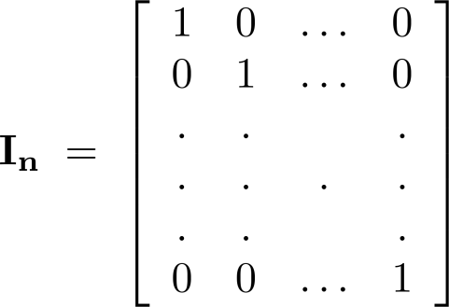
Identity Matrix and Powers of Matrices
Definition: The identity matrix of order n is the m n matrix I_{n} = [δ_{ij}], where δ_{ij} = 1 if i = j and δ_{ij} = 0 if i≠j.
AI_{n} = I_{m}A = A
when A is an m n matrix
Powers of square matrices can be defined. When A is an n × n matrix, we have:
A⁰ = I_{n} A^{r} = AAA∙∙∙A
r times

Slide 45
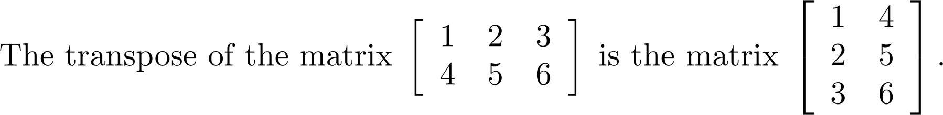
Transposes of Matrices
Definition: Let A = [a_{ij}] be an m n matrix. The transpose of A, denoted by A^{t} ,is the n m matrix obtained by interchanging the rows and columns of A.
  If A^{t} = [b_{ij}], then b_{ij} = a_{ji} for i =1,2,…,n and j = 1,2, ...,m.

Slide 46
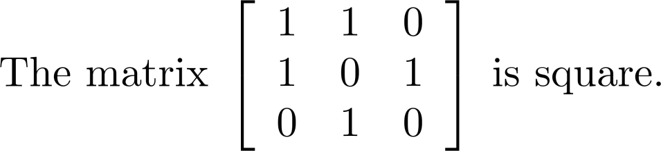
Transposes of Matrices
Definition: A square matrix A is called symmetric if A = A^{t}. Thus A = [a_{ij}] is symmetric if a_{ij} = a_{ji} for i and j with 1≤ i≤ n and 1≤ j≤ n.
Square matrices do not change when their rows and columns are interchanged.

Slide 47
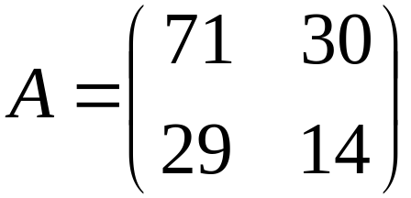
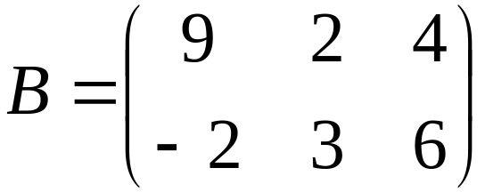
Special Matrices
A square matrix is one in which
No. of rows = No. of columns
Square matrix Not a square matrix

Slide 48
Unit matrix (or Identity matrix)
A unit matrix I is a square matrix with all elements in the diagonal equal to 1 and all off-diagonal elements equal to 0.
1 0 0
    I = 0 1 0 0 0 1
Unit matrix behaves like the unit factor in ordinary algebra where IM = MI = M

Slide 49
Diagonal matrix
A diagonal matrix M is a square matrix such that all of the off- diagonal elements are equal to 0.
  1 0 0
  M = 0 -5 0 0 0 2
diagonal

Slide 50
Symmetric matrix
A square matrix M is symmetric if M = M^{T}
1 2 5 1 2 5
M = 2 8 9 M^{T} = 2 8 9
5 9 4 5 9 4

Slide 51
Zero-One Matrices
Definition: A matrix all of whose entries are either 0 or 1 is called a zero-one matrix. These will be used in
graph theory and other fields.

Slide 52
Matrices
Matrices are useful discrete structures that can be used in many ways. For example, they are used to:
  describe certain types of functions known as linear transformations.
  Express which vertices of a graph are connected by edges (see Chapter 10).
In later chapters, we will see matrices used to build models of:
  Transportation systems.
  Communication networks.
Here we cover the aspect of matrix arithmetic that will be needed later.

