Slide 1
Matrices
Section 2.6

Slide 2
Section Summary
Definition of a Matrix
Matrix Arithmetic
Transposes and Powers of Arithmetic
Zero-One matrices

Slide 3
Matrices
Matrices are useful discrete structures that can be used in many ways. For example, they are used to:
  describe certain types of functions known as linear transformations.
  Express which vertices of a graph are connected by edges (see Chapter 10).
In later chapters, we will see matrices used to build models of:
  Transportation systems.
  Communication networks.
Here we cover the aspect of matrix arithmetic that will be needed later.

Slide 4

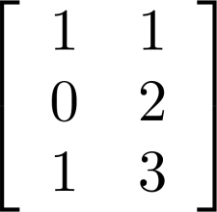
Matrix
Definition: A matrix is a rectangular array of numbers. A matrix with m rows and n columns is called an m n matrix.
  The plural of matrix is matrices.
  A matrix with the same number of rows as columns is called square.
  Two matrices are equal if they have the same number of rows and the same number of columns and the corresponding entries in every position are equal.
3 2 matrix

Slide 5
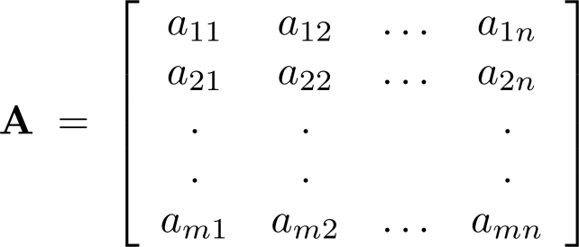
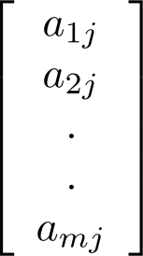
Notation
Let m and n be positive integers and let
The ith row of A is the 1 n matrix [a_{i1}, a_{i2},…,a_{in}]. The jth column of A is the m 1 matrix:
The (i,j)th element or entry of A is the
element a_{ij}. We can use A = [a_{ij} ] to denote the matrix with its (i,j)th element equal to a_{ij}.

Slide 6
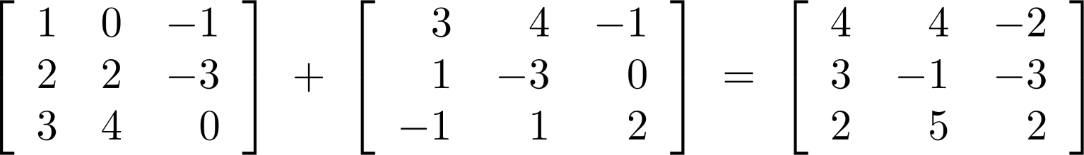
Matrix Arithmetic: Addition
Definition: Let A = [a_{ij}] and B = [b_{ij}] be m n matrices. The sum of A and B, denoted by A + B, is the m n matrix that has a_{ij} + b_{ij} as its (i,j)th element. In other words, A + B = [a_{ij} + b_{ij}].
Example:
Note that matrices of different sizes can not be added.

Slide 7
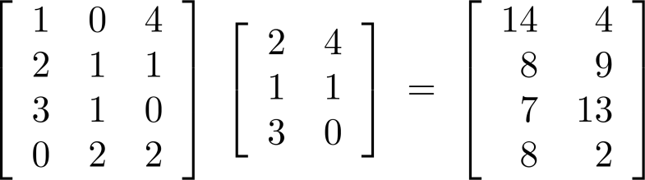
Matrix Multiplication
Definition: Let A be an n k matrix and B be a k n matrix. The product of A and B, denoted by AB, is the m n matrix that has its (i,j)th element equal to the sum of the products of the corresponding elments from the ith row of A and the jth column of B. In other words, if AB = [c_{ij}] then c_{ij} = a_{i1}b_{1j} + a_{i2}b_{2j} + … + a_{kj}b_{2j}.
Example:
The product of two matrices is undefined when the number of columns in the first matrix is not the same as the number of rows in the second.

Slide 8
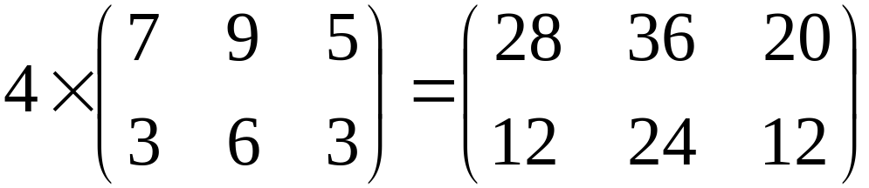
Multiplication of Matrices
  Scalar multiplication
  i.e. k[a_{ij}] = [ka_{ij}]
  This also means that we can take a common factor out of every element.

Slide 9
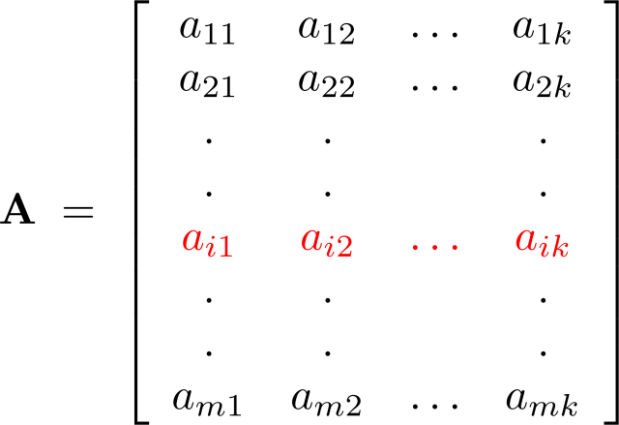
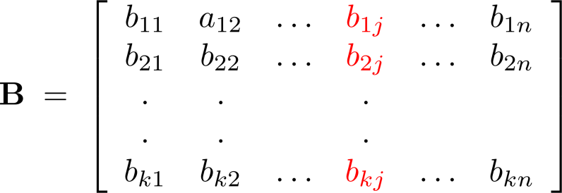
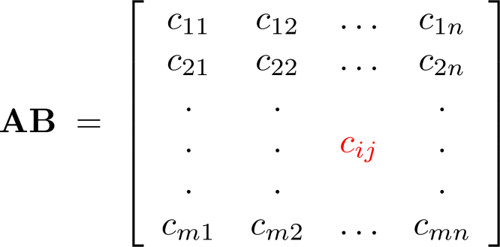
Illustration of Matrix Multiplication
The Product of A = [a_{ij}] and B = [b_{ij}]

Slide 10
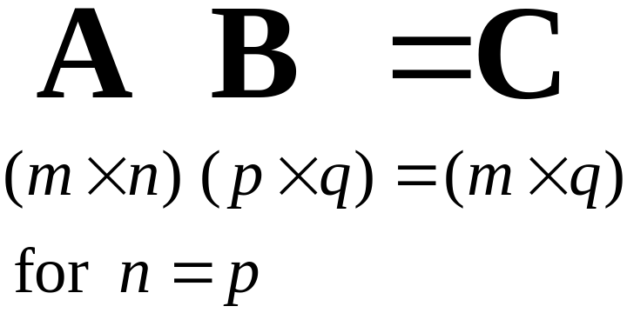
Multiplication of two matrices
    Two matrices can be multiplied together only when the number of columns in the matrix on the left equals the number of rows in the matrix on the right.

Slide 11
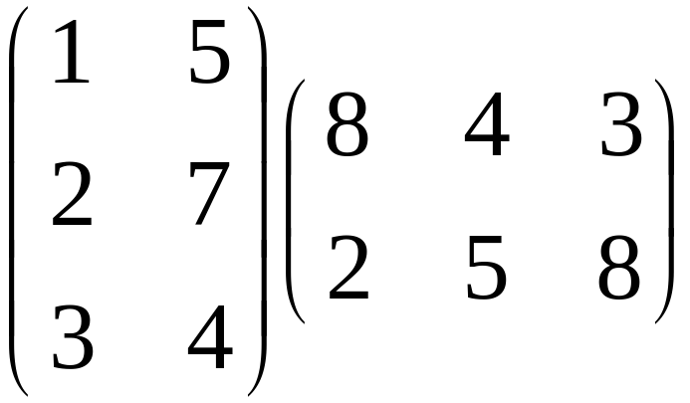
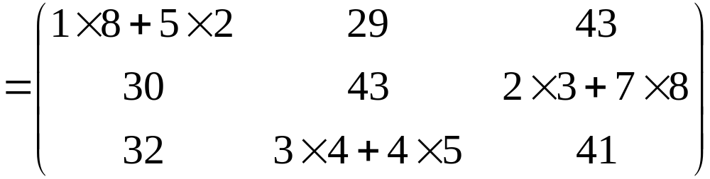

Slide 12
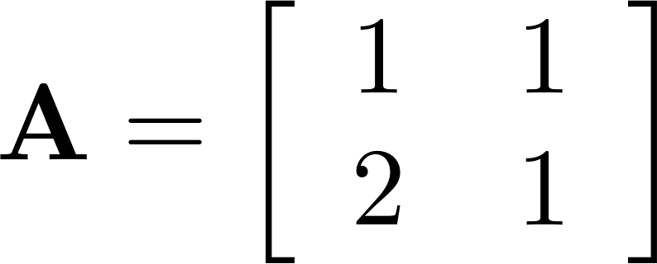
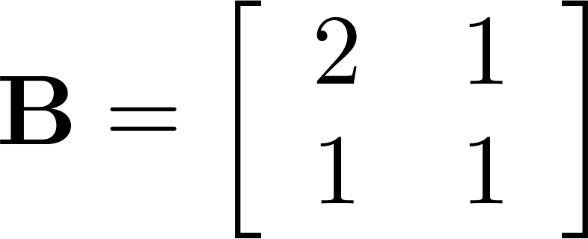
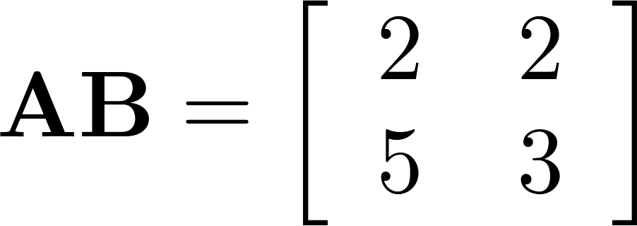
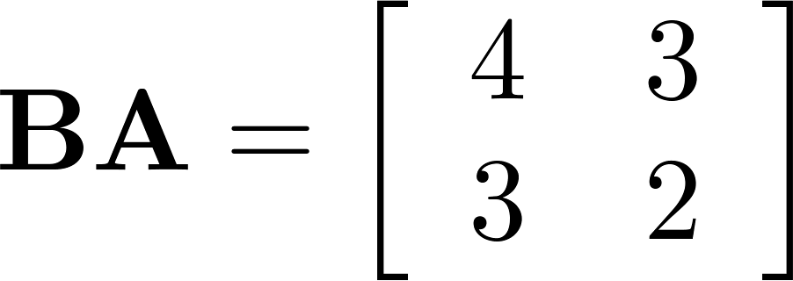
Matrix Multiplication is not Commutative
Example: Let
Does AB = BA?
Solution:
AB ≠ BA

Slide 13
Matrix multiplication is not commutative
      5 2
      A = 7 4 and B = 9 2 4
        3 1 -2 3 6
      41 16 32
      then AB = 55 52 52 and BA = 71 30
      25 9 18 29 14

Slide 14
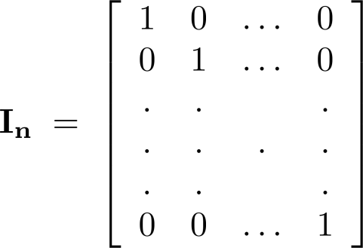
Identity Matrix and Powers of Matrices
Definition: The identity matrix of order n is the m n matrix I_{n} = [δ_{ij}], where δ_{ij} = 1 if i = j and δ_{ij} = 0 if i≠j.
AI_{n} = I_{m}A = A
when A is an m n matrix
Powers of square matrices can be defined. When A is an n × n matrix, we have:
A⁰ = I_{n} A^{r} = AAA∙∙∙A
r times

Slide 15
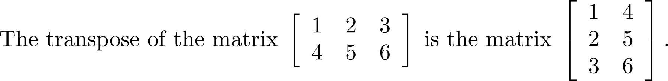
Transposes of Matrices
Definition: Let A = [a_{ij}] be an m n matrix. The transpose of A, denoted by A^{t} ,is the n m matrix obtained by interchanging the rows and columns of A.
  If A^{t} = [b_{ij}], then b_{ij} = a_{ji} for i =1,2,…,n and j = 1,2, ...,m.

Slide 16
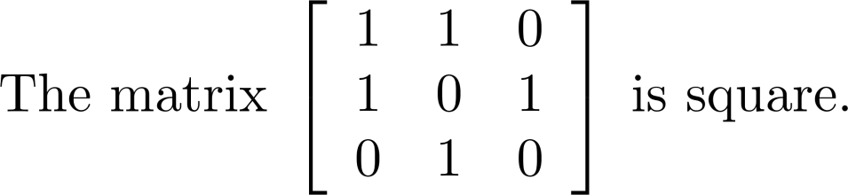
Transposes of Matrices
Definition: A square matrix A is called symmetric if A = A^{t}. Thus A = [a_{ij}] is symmetric if a_{ij} = a_{ji} for i and j with 1≤ i≤ n and 1≤ j≤ n.
Square matrices do not change when their rows and columns are interchanged.

Slide 17
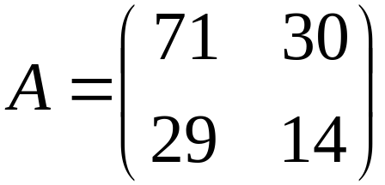
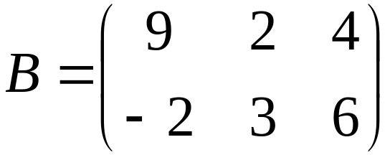
Special Matrices
A square matrix is one in which
No. of rows = No. of columns
Square matrix Not a square matrix

Slide 18
Unit matrix (or Identity matrix)
A unit matrix I is a square matrix with all elements in the diagonal equal to 1 and all off-diagonal elements equal to 0.
1 0 0
    I = 0 1 0 0 0 1
Unit matrix behaves like the unit factor in ordinary algebra where IM = MI = M

Slide 19
Diagonal matrix
A diagonal matrix M is a square matrix such that all of the off- diagonal elements are equal to 0.
  1 0 0
  M = 0 -5 0 0 0 2
diagonal

Slide 20
Symmetric matrix
A square matrix M is symmetric if M = M^{T}
1 2 5 1 2 5
M = 2 8 9 M^{T} = 2 8 9
5 9 4 5 9 4

Slide 21
Zero-One Matrices
Definition: A matrix all of whose entries are either 0 or 1 is called a zero-one matrix. These will be used in
graph theory and other fields.

