Slide 1
Tuples
The ordered n-tuple (a₁,a₂,…..,a_{n}) is the ordered collection that has a₁ as its first element and a₂ as its second element and so on until a_{n} as its last element.
Two n-tuples are equal if and only if their corresponding elements are equal.
2-tuples are called ordered pairs.
The ordered pairs (a, b) and (c, d) are equal if and only if a = c and b = d.

Slide 2
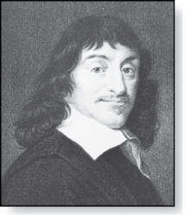
Cartesian Product
René Descartes (1596-1650)
Definition: The Cartesian Product of two sets A and B, denoted by A × B is the set of ordered pairs (a,b) where a ∈ A and b ∈ B .
Example:
A = {a, b} B = {1, 2, 3}
A × B = {(a,1),(a,2),(a,3), (b,1),(b,2),(b,3)}
Definition: A subset R of the Cartesian product A × B is called a relation from the set A to the set B. (Relations will be covered in depth in Chapter 9. )

Slide 3
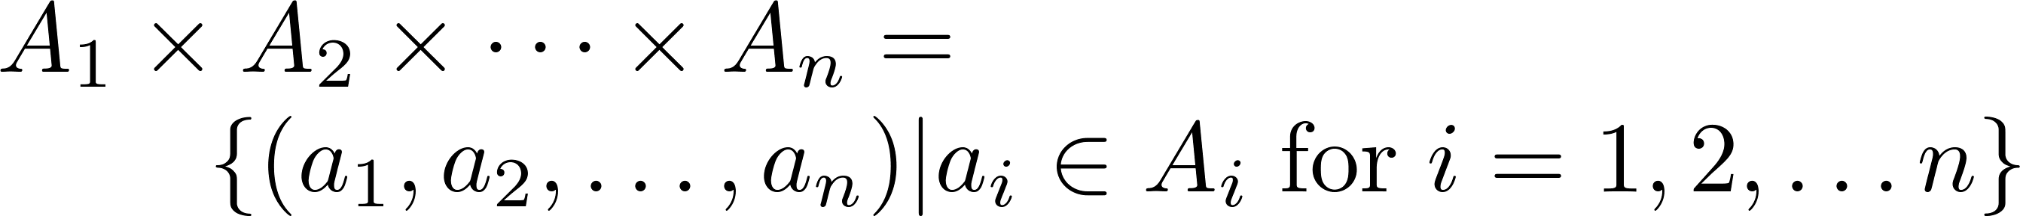
Cartesian Product
Definition: The cartesian products of the sets A₁,A₂,……,A_{n}, denoted by A₁ × A₂ × …… × A_{n} , is the set of ordered n-tuples (a₁,a₂,……,a_{n}) where a_{i} belongs to A_{i} for i = 1, … n.
Example: What is A × B × C where A = {0,1}, B = {1,2} and C = {0,1,2}
Solution: A × B × C = {(0,1,0), (0,1,1), (0,1,2),(0,2,0), (0,2,1), (0,2,2),(1,1,0), (1,1,1), (1,1,2), (1,2,0), (1,2,1), (1,1,2)}

Slide 4
Relations
Chapter 9

Slide 5
Relations and Their Properties
Section 9.1

Slide 6
Section Summary
Relations
Properties of Relations
  Reflexive Relations
  Symmetric Relations
  Transitive Relations

Slide 7
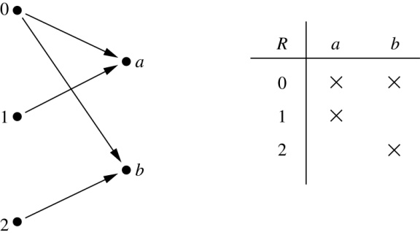
Binary Relations
Definition: A binary relation R from a set A to a set B is a subset R ⊆ A × B.
Example:
  Let A = {0,1,2} and B = {a, b}
  {(0, a), (0, b), (1,a) , (2, b)} is a relation from A to B.
  We can represent relations from a set A to a set B graphically or using a table:
Relations are more general than functions. A function is a relation where exactly one element of B is related to each element of A.

Slide 8
Domain and Range of a relation.
Domain: the set of all the first components in the
ordered pairs of a relation R.
Range: the set of all the second components in the
ordered pairs of a relation R.

Slide 9
Binary Relation on a Set
Definition: A binary relation R on a set A is a subset of A × A or a relation from A to A.
Example:
  Suppose that A = {a,b,c}. Then R = {(a,a),(a,b), (a,c)} is a relation on A.
  Let A = {1, 2, 3, 4}. The ordered pairs in the relation R = {(a,b) | a divides b} are
  (1,1), (1, 2), (1,3), (1, 4), (2, 2), (2, 4), (3, 3), and (4, 4).

Slide 10
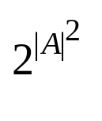
Binary Relation on a Set (cont.)
    Question: How many relations are there on a set A?
    Solution: Because a relation on A is the same thing as a subset of A ⨉ A, we count the subsets of A × A. Since A × A has n² elements when A has n elements, and a set with m elements has 2^{m} subsets, there are subsets of A × A. Therefore, there are relations on a set A.

Slide 11
Binary Relations on a Set (cont.)
Example: Consider these relations on the set of integers:
  R₁ = {(a, b) | a ≤ b}, R₄ = {(a, b) | a = b},
  R₂ = {(a, b) | a > b}, R₅ = {(a, b) | a = b + 1},
  R₃ = {(a, b) | a = b or a = −b}, R₆ = {(a, b) | a + b ≤ 3}.
  Which of these relations contain each of the pairs
  (1,1), (1, 2), (2, 1), (1, −1), and (2, 2)?
Solution: Checking the conditions that define each relation, we see that the pair (1,1) is in R₁, R₃, R₄ , and R₆: (1,2) is in R₁ and R₆: (2,1) is in R₂, R₅, and R₆: (1, −1) is in R₂, R₃, and R₆ : (2,2) is in R₁, R₃, and R₄.
Note that these relations are on an infinite set and each of these relations is an infinite set.

Slide 12
Reflexive Relations
Definition: R is reflexive iff (a, a) ∊ R for every element a ∊ A. Written symbolically, R is reflexive if and only if
∀x[x ∊ U ⟶ (x, x) ∊ R]
Example: The following relations on the integers are reflexive:
  R₁ = {(a, b) | a ≤ b},
  R₃ = {(a, b) | a = b or a = −b},
  R₄ = {(a, b) | a = b}.
  The following relations are not reflexive:
  R₂ = {(a, b) | a > b} (note that 3 ≯ 3),
  R₅ = {(a, b) | a = b + 1} (note that 3 ≠3 + 1),
  R₆ = {(a, b) | a + b ≤ 3} (note that 4 + 4 ≰ 3).
If A = ∅ then the empty relation is reflexive vacuously. That is the empty relation on an empty set is reflexive!

Slide 13
Symmetric Relations
Definition: R is symmetric iff (b, a) ∊ R whenever (a, b) ∊ R for all a, b ∊ A. Written symbolically, R is symmetric if and only if
  ∀x ∀ y [(x, y) ∊R ⟶ (y, x) ∊ R]
Example: The following relations on the integers are symmetric:
  R₃ = {(a, b) | a = b or a = −b},
  R₄ = {(a, b) | a = b},
  R₆ = {(a, b) | a + b ≤ 3}.
  The following are not symmetric:
  R₁ = {(a, b) | a ≤ b} (note that 3 ≤ 4, but 4 ≰ 3),
  R₂ = {(a, b) | a > b} (note that 4 > 3, but 3 ≯ 4),
  R₅ = {(a, b) | a = b + 1} (note that 4 = 3 + 1, but 3 ≠4 + 1).

Slide 14
Transitive Relations
Definition: A relation R on a set A is called transitive if whenever (a, b) ∊ R and (b, c) ∊ R, then (a, c) ∊ R, for all a, b, c ∊ A. Written symbolically, R is transitive if and only if
  ∀x ∀ y ∀z[(x, y) ∊R ∧ (y, z) ∊ R ⟶ (x, z) ∊ R ]
Example: The following relations on the integers are transitive:
  R₁ = {(a, b) | a ≤ b},
  R₂ = {(a, b) | a > b},
  R₃ = {(a, b) | a = b or a = −b},
  R₄ = {(a, b) | a = b}.
  The following are not transitive:
  R₅ = {(a, b) | a = b + 1} (note that both (3, 2) and (4, 3) belong to R₅, but not (3,3)),
  R₆ = {(a, b) | a + b ≤ 3} (note that both (2,1) and (1,2) belong to R₆, but not (2,2)).
For every integer, a ≤ b
and b ≤ c, then b ≤ c.

Slide 15
Representing Relations
Section 9.3

Slide 16
Section Summary
Representing Relations using Matrices
Representing Relations using Digraphs

Slide 17
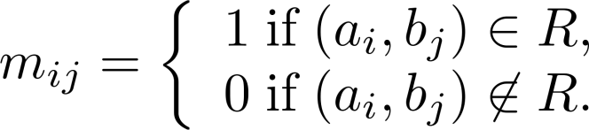
Representing Relations Using Matrices
A relation between finite sets can be represented using a zero-one matrix.
Suppose R is a relation from A = {a₁, a₂, …, a_{m}} to B = {b₁, b₂, …, b_{n}}.
  The elements of the two sets can be listed in any particular arbitrary order. When A = B, we use the same ordering.
The relation R is represented by the matrix M_{R} = [m_{ij}], where
The matrix representing R has a 1 as its (i,j) entry when a_{i} is related to b_{j} and a 0 if a_{i} is not related to b_{j}.

Slide 18
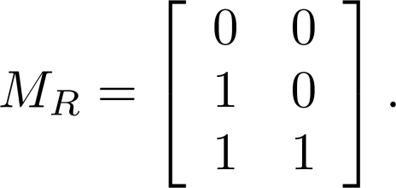
Examples of Representing Relations Using Matrices
Example 1: Suppose that A = {1,2,3} and B = {1,2}. Let R be the relation from A to B containing (a, b) if a ∈ A, b ∈ B, and a > b. What is the matrix representing R (assuming the ordering of elements is the same as the increasing numerical order)?
Solution: Because R = {(2,1), (3,1),(3,2)}, the matrix is

Slide 19
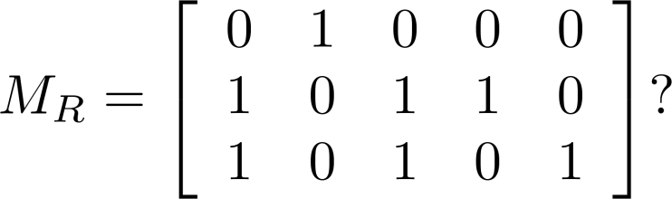
Examples of Representing Relations Using Matrices (cont.)
Example 2: Let A = {a₁,a₂, a₃} and B = {b₁,b₂, b₃, b₄, b₅}. Which ordered pairs are in the relation R represented by the matrix
Solution: Because R consists of those ordered pairs (a_{i}, b_{j}) with m_{ij} = 1, it follows that:
R = {(a₁, b₂), (a₂, b₁),(a₂, b₃), (a₂, b₄),(a₃, b₁), {(a₃, b₃), (a₃, b₅)}.

Slide 20
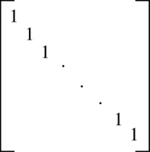
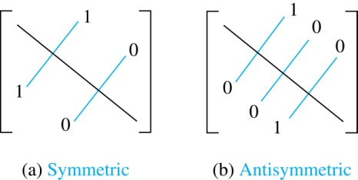
Matrices of Relations on Sets
If R is a reflexive relation, all the elements on the main diagonal of M_{R} are equal to 1.
R is a symmetric relation, if and only if m_{ij} = 1 whenever m_{ji} = 1.

Slide 21
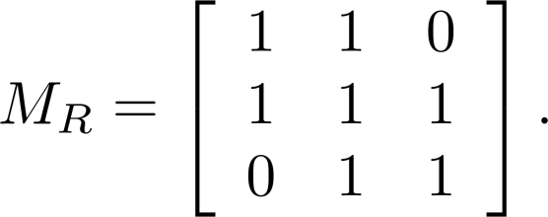
Example of a Relation on a Set
Example 3: Suppose that the relation R on a set is represented by the matrix
Is R reflexive and/or symmetric?
Solution: Because all the diagonal elements are equal to 1, R is reflexive. Because M_{R} is symmetric, R is symmetric.

Slide 22
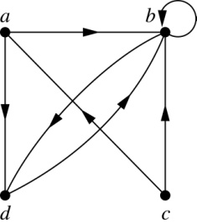
Representing Relations Using Digraphs
Definition: A directed graph, or digraph, consists of a set V of vertices (or nodes) together with a set E of ordered pairs of elements of V called edges (or arcs). The vertex a is called the initial vertex of the edge (a, b), and the vertex b is called the terminal vertex of this edge.
  An edge of the form (a, a) is called a loop.
Example 7: A drawing of the directed graph with vertices a, b, c, and d, and edges (a, b), (a, d), (b, b), (b, d), (c, a), (c, b), and (d, b) is shown here.

Slide 23
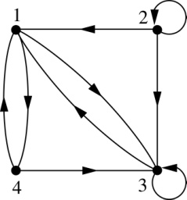
Examples of Digraphs Representing Relations
Example 8: What are the ordered pairs in the relation
represented by this directed graph?
Solution: The ordered pairs in the relation are
(1, 3), (1, 4), (2, 1), (2, 2), (2, 3), (3, 1), (3, 3), (4, 1), and (4, 3)

Slide 24
Determining which Properties a Relation has from its Digraph
Reflexivity: A loop must be present at all vertices in the graph.
Symmetry: If (x, y) is an edge, then so is (y, x).
Transitivity: If (x, y) and (y, z) are edges, then
so is (x, z).

Slide 25
Determining which Properties a Relation has from its Digraph – Example 1
a
b
c
d
Reflexive? No, not every vertex has a loop
Symmetric? Yes (trivially), there is no edge from one vertex to another
Transitive? Yes, (trivially) since there is no edge from one vertex to another

Slide 26
Determining which Properties a Relation has from its Digraph – Example 2
a
b
c
d
Reflexive? No, there are no loops
Symmetric? No, there is an edge from a to b, but not from b to a
Transitive? No, there are edges from a to b and from b to d,
but there is no edge from a to d

Slide 27
Determining which Properties a Relation has from its Digraph – Example 3
a
b
c
d
Reflexive? No, there are no loops
Symmetric? No, for example, there is no edge from c to a
Transitive? No, there is no edge from a to b

Slide 28
Equivalence Relations
Section 9.5

Slide 29
Section Summary
Equivalence Relations
Equivalence Classes
Equivalence Classes and Partitions

Slide 30
Equivalence Relations
Definition 1: A relation on a set A is called an equivalence relation if it is reflexive, symmetric, and transitive.
Definition 2: Two elements a, and b that are related by an equivalence relation are called equivalent. The notation a ∼ b is often used to denote that a and b are equivalent elements with respect to a particular equivalence relation.

Slide 31
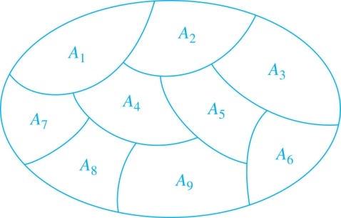
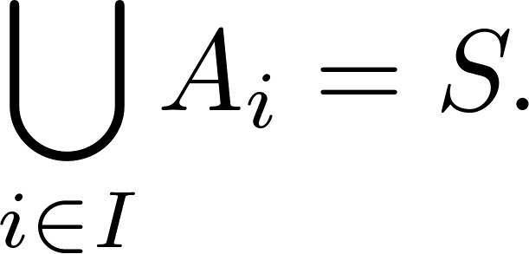
Partition of a Set
Definition: A partition of a set S is a collection of disjoint nonempty subsets of S that have S as their union. In other words, the collection of subsets A_{i}, where i ∈ I (where I is an index set), forms a partition of S if and only if
  A_{i} ≠ ∅ for i ∈ I,
  A_{i} ∩ A_{j}=∅ when i ≠ j,
  and
A Partition of a Set

Slide 32
A partition yields an equivalence relation
Suppose A = P1 U P2 U P3 U … U Pk.
Then (P1 X P1) U (P2 X P2) U (P3 x P3) … (Pk X Pk)
is an equivalence relation on A.
Example. A = {1, 2, 3, 4} = P1 U P2, where P1 = {1, 4} and
P2 = {2, 3}.
Then P1 X P1 = {(1, 1), (1, 4), (4, 1), (4, 4)} and
P2 X P2 = {(2, 2), (2, 3), (3, 2), (3, 3)}.
So (P1 X P1) U (P2 X P2) = {(1, 1), (1, 4), (4, 1), (4, 4),
(2, 2), (2, 3), (3, 2), (3, 3)}
is an equivalence relation on A.

Slide 33
Strings
Example: Suppose that R is the relation on the set of strings of English letters such that aRb if and only if l(a) = l(b), where l(x) is the length of the string x. Is R an equivalence relation?
Solution: Show that all of the properties of an equivalence relation hold.
  Reflexivity: Because l(a) = l(a), it follows that aRa for all strings a.
  Symmetry: Suppose that aRb. Since l(a) = l(b), l(b) = l(a) also holds and bRa.
  Transitivity: Suppose that aRb and bRc. Since l(a) = l(b),and l(b) = l(c), l(a) = l(a) also holds and aRc.

Slide 34
Divides
Example: Show that the “divides” relation on the set of positive integers is not an equivalence relation.
Solution: The properties of reflexivity, and transitivity do hold, but there relation is not transitive. Hence, “divides” is not an equivalence relation.
  Reflexivity: a ∣ a for all a.
  Not Symmetric: For example, 2 ∣ 4, but 4 ∤ 2. Hence, the relation is not symmetric.
  Transitivity: Suppose that a divides b and b divides c. Then there are positive integers k and l such that b = ak and c = bl. Hence, c = a(kl), so a divides c. Therefore, the relation is transitive.

Slide 35
Equivalence classes
Consider the relation R = { (a,b) | a mod 2 = b mod 2 }
  Thus, all the even numbers are related to each other
  As are the odd numbers
The even numbers form an equivalence class
  As do the odd numbers
The equivalence class for the even numbers is denoted by [2] (or [4], or [784], etc.)
  [2] = { …, -4, -2, 0, 2, 4, … }
  2 is a representative of it’s equivalence class
There are only 2 equivalence classes formed by this equivalence relation

Slide 36
Congruence Modulo 3
Example: Show that the relation
R = {(a, b) | a ≡ b (mod 3)}
is an equivalence relation on the set of integers.
Solution: Recall that a ≡ b (mod 3) if and only if 3 divides a − b.
  Reflexivity: a ≡ a (mod 3) since a − a = 0 is divisible by 3 since 0 = 0 ∙ 3.
  Symmetry: Suppose that a ≡ b (mod 3). Then a − b is divisible by 3, and so a − b = k*3, where k is an integer. It follows that b − a = (− k)*3, so b ≡ a (mod 3).
  Transitivity: Suppose that a ≡ b (mod 3) and b ≡ c (mod 3). Then 3 divides both a − b and b − c. Hence, there are integers k and l with a − b = k*3 and b − c = l*3. We obtain by adding the equations:
  a − c = (a − b) + (b − c) = k*3 + l*3 = (k + l)*3.
  Therefore, a ≡ c (mod 3).

Slide 37
Congruence Modulo 7
Example: Show that the relation
R = {(a, b) | a ≡ b (mod 7)}
is an equivalence relation on the set of integers.
Solution: Recall that a ≡ b (mod 7) if and only if 7 divides a − b.
  Reflexivity: a ≡ a (mod 7) since a − a = 0 is divisible by 7 since 0 = 0 ∙ 7.
  Symmetry: Suppose that a ≡ b (mod 7). Then a − b is divisible by 7, and so a − b = k*7, where k is an integer. It follows that b − a = (− k) *7, so b ≡ a (mod 7).
  Transitivity: Suppose that a ≡ b (mod 7) and b ≡ c (mod 7). Then 7 divides both a − b and b − c. Hence, there are integers k and l with a − b = k*7 and b − c = l*7. We obtain by adding the equations:
  a − c = (a − b) + (b − c) = k*7 + l*7 = (k + l)*7.
  Therefore, a ≡ c (mod 7).

Slide 38
Congruence Modulo m
Example: Let m be an integer with m > 1. Show that the relation
R = {(a, b) | a ≡ b (mod m)}
is an equivalence relation on the set of integers.
Solution: Recall that a ≡ b (mod m) if and only if m divides a − b.
  Reflexivity: a ≡ a (mod m) since a − a = 0 is divisible by m since 0 = 0 ∙ m.
  Symmetry: Suppose that a ≡ b (mod m). Then a − b is divisible by m, and so a − b = km, where k is an integer. It follows that b − a = (− k) m, so b ≡ a (mod m).
  Transitivity: Suppose that a ≡ b (mod m) and b ≡ c (mod m). Then m divides both a − b and b − c. Hence, there are integers k and l with a − b = km and b − c = lm. We obtain by adding the equations:
  a − c = (a − b) + (b − c) = km + lm = (k + l) m.
  Therefore, a ≡ c (mod m).

Slide 39
Equivalence classes
Consider the relation R = { (a,b) | a = b or
a = -b }
  Thus, every number is related to additive inverse
The equivalence class for an integer a:
  [7] = { 7, -7 }
  [0] = { 0 }
  [a] = { a, -a }
There are an infinite number of equivalence classes formed by this equivalence relation

Slide 40
Equivalence Classes
Definition 3: Let R be an equivalence relation on a set A. The set of all elements that are related to an element a of A is called the equivalence class of (represented by) a. The equivalence class of a with respect to R is denoted by R(a) = [a]_{R}. When only one relation is under consideration, we can write [a], without the subscript R, for this equivalence class.
Note that [a]_{R} = R(a) = {s|(a, s) ∈ R}. This is the equivalence class represented by a.
If b ∈ [a]_{R}, then b is also called a representative of this equivalence class. Any element of a class can be used as a representative of the class.

Slide 41
Congruence Modulo 3
Example: the relation
R = {(a, b) | a ≡ b (mod 3)}
is an equivalence relation on the set A of integers.
  [0]₃ = R(0) = {…, −6, −3, 0, 3, 6, …} (= R(-6) = R(-3)
  = R(3) = R(6))
  [1]₃ = R(1) = {…, −5, −2, 1, 4, 7, …} (= R(-5) = R(-2)
  = R(4) = R(7))
  [2]₃ = R(2) = {…, −4, −1, 2, 5, 8, …} (= R(-4) = R(-1)
  = R(5) = R(8))

Slide 42
Equivalence Classes
The equivalence classes of the relation congruence modulo m are called the congruence classes modulo m. The congruence class of an integer a modulo m is denoted by [a]_{m},
It can be verified that
[a]_{m} = {…, a−2m, a−m, a+2m, a+2m, … }.

Slide 43
Equivalence Classes and Partitions
Theorem 1: let R be an equivalence relation on a set A. These statements for elements a and b of A are equivalent:
  (i) aRb
  (ii) [a] = [b]
  (iii) [a] ∩ [b] = ∅
  Proof: We show that (i) implies (ii). Assume that aRb. Now suppose that c ∈ [a]. Then aRc. Because aRb and R is symmetric, bRa. Because R is transitive and bRa and aRc, it follows that bRc. Hence, c ∈ [b]. Therefore, [a]⊆ [b]. A similar argument (omitted here) shows that [b]⊆ [a]. Since [a]⊆ [b] and [b]⊆ [a], we have shown that [a] = [b].
(see text for proof that (ii) implies (iii) and (iii) implies (i))

Slide 44
Partitions
Consider the relation R = {(a, b) | a mod 2 = b mod 2 }
This splits the integers into two equivalence classes: even numbers and odd numbers
Those two sets together form a partition of the integers
Formally, a partition of a set S is a collection of non-empty disjoint subsets of S whose union is S
In this example, the partition is
{R(0), R(1)} or { {…, -3, -1, 1, 3, …}, {…, -4, -2, 0, 2, 4, …} }

Slide 45
Congruence Modulo 3
Example: the relation
R = {(a, b) | a ≡ b (mod 3)}
is an equivalence relation on the set A of integers.
  [0]₃ = R(0) = {…, −6, −3, 0, 3, 6, …} (= R(-6) = R(-3)
  = R(3) = R(6))
  [1]₃ = R(1) = {…, −5, −2, 1, 4, 7, …} (= R(-5) = R(-2)
  = R(4) = R(7))
  [2]₃ = R(2) = {…, −4, −1, 2, 5, 8, …} (= R(-4) = R(-1)
  = R(5) = R(8))
  A = R(0) U R(1) U R(2), a partition of A.

Slide 46
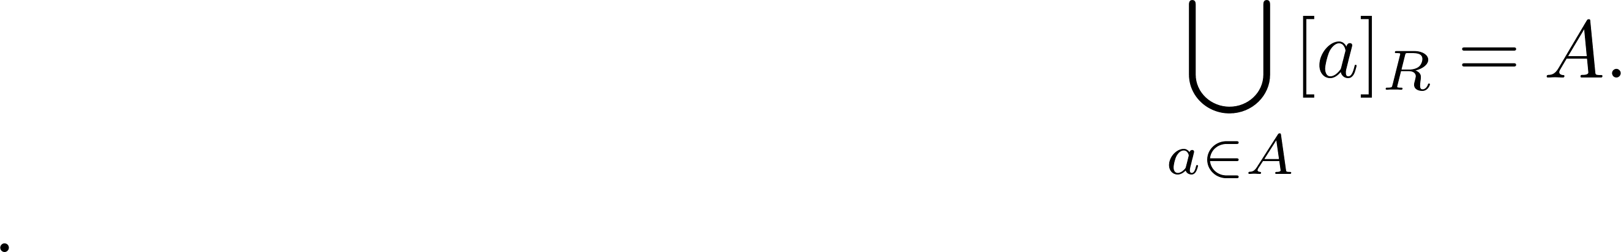
An Equivalence Relation Partitions a Set
Let R be an equivalence relation on a set A. The union of all the equivalence classes of R is all of A, since an element a of A is in its own equivalence class [a]_{R}. In other words,
U R(a) = A.
From Theorem 1, it follows that these equivalence classes are either equal or disjoint, so [a]_{R} ∩[b]_{R}=∅ when [a]_{R} ≠ [b]_{R}.
Therefore, the equivalence classes form a partition of A, because they split A into disjoint subsets.

