Slide 1
Graphs
Chapter 10

Slide 2
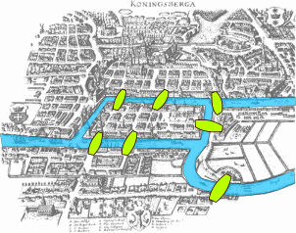
The Seven Bridges of Königsberg

Slide 3
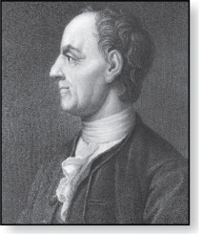
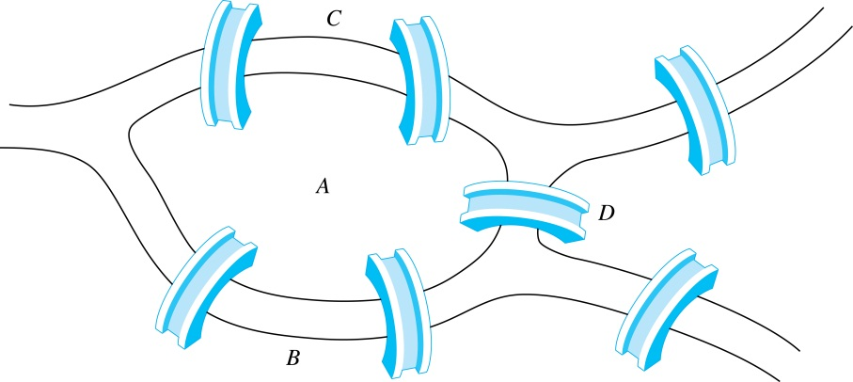
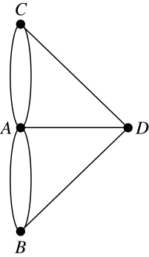
The Königsberg Bridge Problem
Leonard Euler (1707-1783)
The town of Kӧnigsberg, Prussia (now Kalingrad, Russia) was divided into four sections by the branches of the Pregel river. In the 18th century seven bridges connected these regions.
People wondered whether it was possible to follow a path that crosses each bridge exactly once and returns to the starting point.
The Swiss mathematician Leonard Euler proved that no such path exists. This result is often considered to be the first theorem ever proved in graph theory.
Multigraph Model of the Bridges of Kӧnigsberg
The 7 Bridges of Kӧnigsberg

Slide 4
Graphs
Definition: A graph G = (V, E) consists of a nonempty set V of vertices (or nodes) and a set E of edges. Each edge has either one or two vertices associated with it, called its endpoints. An edge is said to incident its endpoints.
f
d e g i
h
k l
j
a
b
c

Slide 5
Graphs
Definition: A graph G = (V, E) consists of a nonempty set V of vertices (or nodes) and a set E of edges. Each edge has either one or two vertices associated with it, called its endpoints. An edge is said to be incident its endpoints.
Remarks:
  The graphs we study here are unrelated to graphs of functions studied in Chapter 2.
  We have a lot of freedom when we draw a picture of a graph. All that matters is the connections made by the edges, not the particular geometry depicted. For example, the lengths of edges, whether edges cross, how vertices are depicted, and so on, do not matter
  A graph with an infinite vertex set is called an infinite graph. A graph with a finite vertex set is called a finite graph. We (following the text) restrict our attention to finite graphs.
a
b
d
c

Slide 6
Graphs
-In a simple graph each edge connects two different vertices and no two edges
connect the same pair of vertices.
-An edge that connects a vertex to itself is called a loop.
-A vertex is called an isolated vertex if no edges are incident to it.
-Two vertices are adjacent if there is an edge connecting them.
-Order: number of vertices.
-Size: number of edges.
f
d e g
a
b
c

Slide 7
Graphs have a lots of applications
They are used as models to solve problems
in different fields.

Slide 8
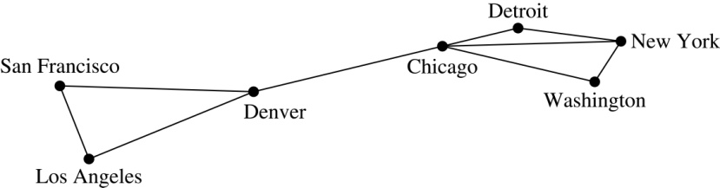
Graph Models:
Computer Networks
When we build a graph model, we use the appropriate type of graph to capture the important features of the application.
We illustrate this process using graph models of different types of computer networks. In all these graph models, the vertices represent data centers and the edges represent communication links.
To model a computer network where we are only concerned whether two data centers are connected by a communications link, we use a simple graph. This is the appropriate type of graph when we only care whether two data centers are directly linked (and not how many links there may be) and all communications links work in both directions.

Slide 9
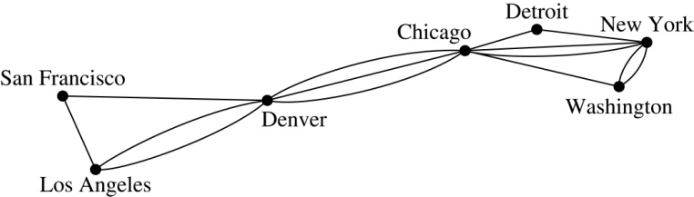
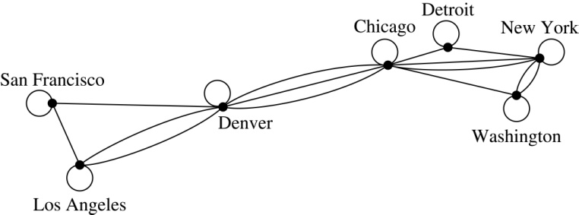
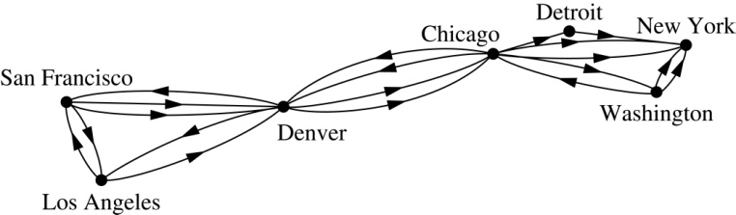
Graph Models:
Computer Networks (continued)
To model a computer network where we care about the number of links between data centers, we use a multigraph.
To model a computer network with diagnostic links at data centers, we use a pseudograph, as loops are needed.
To model a network with multiple one-way links, we use a directed multigraph. Note that we could use a directed graph without multiple edges if we only care whether there is at least one link from a data center to another data center.

Slide 10
Other Applications of Graphs
  We will illustrate how graph theory can be used in models of communications networks.
Other applications.
  Social networks
  Information networks
  Software design
  Transportation networks
  Biological networks

Slide 11
Graph Models: Social Networks
Graphs can be used to model social structures based on different kinds of relationships between people or groups.
In a social network, vertices represent individuals or organizations and edges represent relationships between them.
Useful graph models of social networks include:
  friendship graphs - undirected graphs where two people are connected if they are friends (in the real world, on Facebook, or in a particular virtual world, and so on.)
  collaboration graphs - undirected graphs where two people are connected if they collaborate in a specific way
  influence graphs - directed graphs where there is an edge from one person to another if the first person can influence the second person

Slide 12
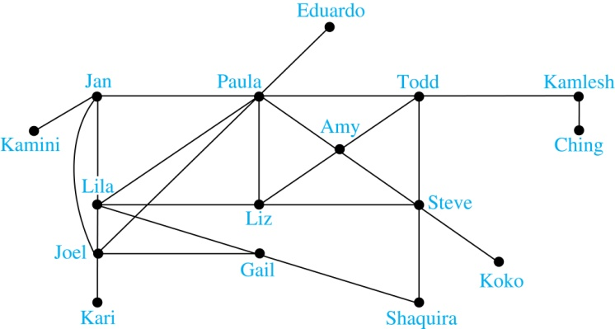
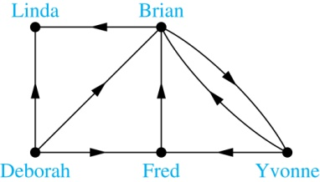
Graph Models: Social Networks (continued)
Example: A friendship graph where two people are connected if they are Facebook friends.
Example: An influence graph
Next Slide: Collaboration Graphs

Slide 13
Examples of Collaboration Graphs
The Hollywood graph models the collaboration of actors in films.
  We represent actors by vertices and we connect two vertices if the actors they represent have appeared in the same movie.
  We will study the Hollywood Graph in Section 10.4 when we discuss Kevin Bacon numbers.
An academic collaboration graph models the collaboration of researchers who have jointly written a paper in a particular subject.
  We represent researchers in a particular academic discipline using vertices.
  We connect the vertices representing two researchers in this discipline if they are coauthors of a paper.
  We will study the academic collaboration graph for mathematicians when we discuss Erdős numbers in Section 10.4.

Slide 14
Applications to Information Networks
Graphs can be used to model different types of networks that link different types of information.
In a web graph, web pages are represented by vertices and links are represented by directed edges.
  A web graph models the web at a particular time.
  We will explain how the web graph is used by search engines in Section 11.4.
In a citation network:
  Research papers in a particular discipline are represented by vertices.
  When a paper cites a second paper as a reference, there is an edge from the vertex representing this paper to the vertex representing the second paper.

Slide 15
Transportation Graphs
Graph models are extensively used in the study of transportation networks.
Airline networks can be modeled using directed multigraphs where
  airports are represented by vertices
  each flight is represented by a directed edge from the vertex representing the departure airport to the vertex representing the destination airport
Road networks can be modeled using graphs where
  vertices represent intersections and edges represent roads.
  undirected edges represent two-way roads and directed edges represent one-way roads.

Slide 16
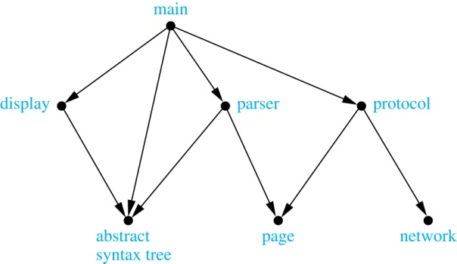
Software Design Applications
Graph models are extensively used in software design. We will introduce two such models here; one representing the dependency between the modules of a software application and the other representing restrictions in the execution of statements in computer programs.
When a top-down approach is used to design software, the system is divided into modules, each performing a specific task.
We use a module dependency graph to represent the dependency between these modules. These dependencies need to be understood before coding can be done.
  In a module dependency graph vertices represent software modules and there is an edge from one module to another if the second module depends on the first.
Example: The dependencies between the seven modules in the design of a web browser are represented by this module dependency graph.

Slide 17
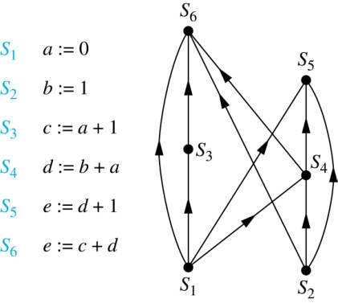
Software Design Applications (continued)
We can use a directed graph called a precedence graph to represent which statements must have already been executed before we execute each statement.
  Vertices represent statements in a computer program
  There is a directed edge from a vertex to a second vertex if the second vertex cannot be executed before the first
Example: This precedence graph shows which statements must already have been executed before we can execute each of the six statements in the program.

Slide 18
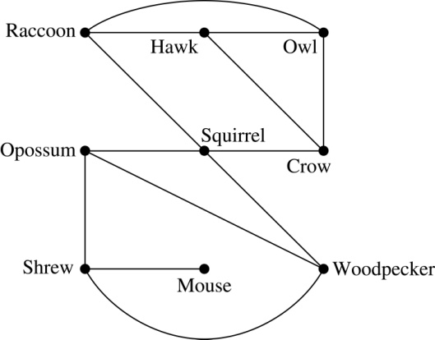
Biological Applications
Graph models are used extensively in many areas of the biological science. We will describe two such models, one to ecology and the other to molecular biology.
Niche overlap graphs model competition between species in an ecosystem
  Vertices represent species and an edge connects two vertices when they represent species who compete for food resources.
Example: This is the niche overlap graph for a forest ecosystem with nine species.

Slide 19
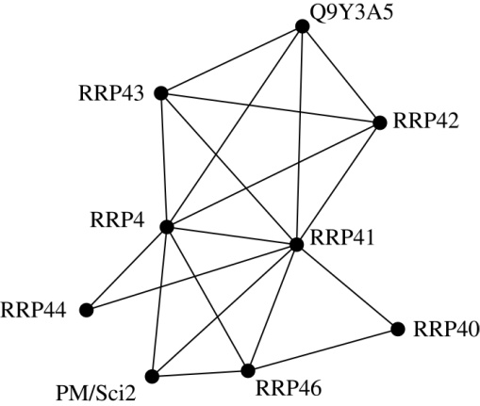
Biological Applications (continued)
We can model the interaction of proteins in a cell using a protein interaction network.
In a protein interaction graph, vertices represent proteins and vertices are connected by an edge if the proteins they represent interact.
Protein interaction graphs can be huge and can contain more than 100,000 vertices, each representing a different protein, and more than 1,000,000 edges, each representing an interaction between proteins
Protein interaction graphs are often split into smaller graphs, called modules, which represent the interactions between proteins involved in a particular function.
Example: This is a module of the protein interaction graph of proteins that degrade RNA in a human cell.

Slide 20
Graphs
-Definition. Two vertices u, v in an undirected graph G are called adjacent (or neighbors) in G if there is an edge e between u and v. Such an edge e is called incident with the vertices u and v and e is said to connect u and v.
-Definition. The degree of a vertex in a undirected graph is the number of edges incident with it, except that a loop at a vertex contributes two to the degree of that vertex. The degree of the vertex v is denoted by deg(v).

Slide 21
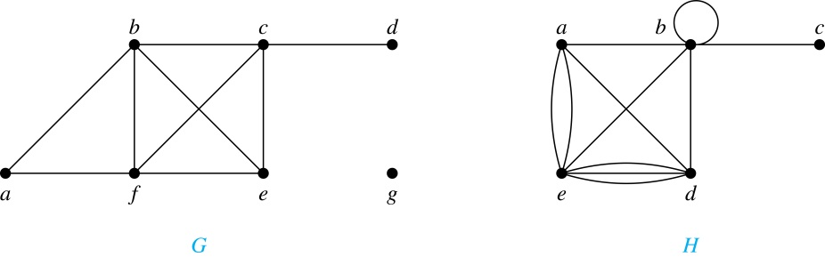
Degrees of Vertices
Example: What are the degrees of the vertices in the graphs G and H?
Solutions:
G: deg(a) = 2, deg(b) = deg(c) = deg(f ) = 4, deg(d ) = 1,
deg(e) = 3, deg(g) = 0.
H: deg(a) = 4, deg(b) = deg(e) = 6, deg(c) = 1, deg(d) = 5.

Slide 22
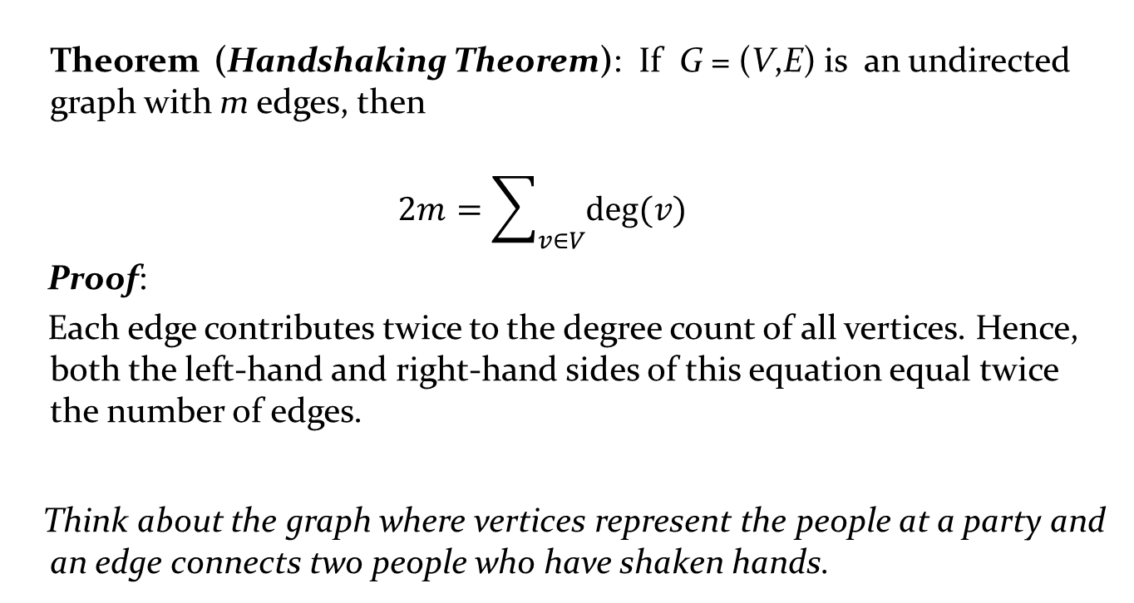
Degrees of Vertices
Theorem (Handshaking Theorem): If G = (V,E) is an undirected graph with m edges, then
$$2m=\sum_{v∈V}{deg⁡(v)}$$
Proof:
Each edge contributes twice to the degree count of all vertices. Hence, both the left-hand and right-hand sides of this equation equal twice the number of edges.
Think about the graph where vertices represent the people at a party and an edge connects two people who have shaken hands.

Slide 23
Handshaking Theorem
We now give two examples illustrating the usefulness of the handshaking theorem.
Example: How many edges are there in a graph with 10 vertices of degree six?
Solution: Because the sum of the degrees of the vertices is 6 ⋅ 10 = 60, the handshaking theorem tells us that 2m = 60. So the number of edges m = 30.
Example: If a graph has 5 vertices, can each vertex have degree 3?
Solution: This is not possible by the handshaking thorem, because the sum of the degrees of the vertices 3 ⋅ 5 = 15 is odd.

Slide 24
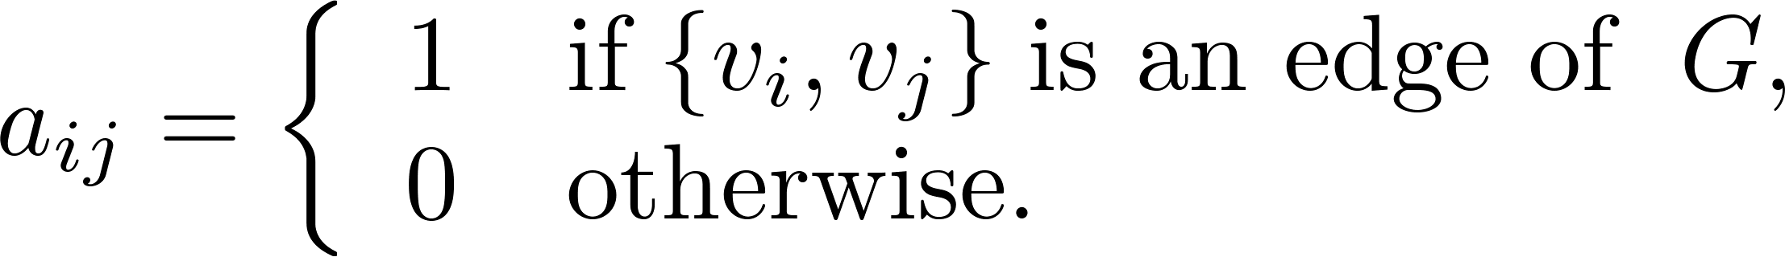
Representation of Graphs: Adjacency Matrices
Definition: Suppose that G = (V, E) is a simple graph where |V| = n. Arbitrarily list the vertices of G as v₁, v₂, … , v_{n}. The adjacency matrix A_{G} of G, with respect to the listing of vertices, is the n × n zero-one matrix with 1 as its (i, j)th entry when v_{i} and v_{j} are adjacent, and 0 as its (i, j)th entry when they are not adjacent.
  In other words, if the graphs adjacency matrix is A_{G} = [a_{ij}], then

Slide 25
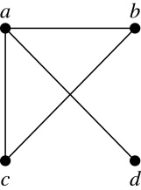
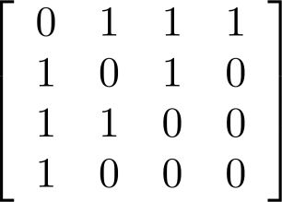
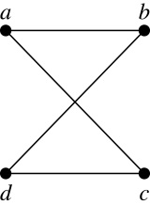
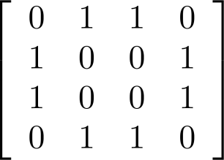
Adjacency Matrices (continued)
Example:
When a graph is sparse, that is, it has few edges relatively to the total number of possible edges, it is much more efficient to represent the graph using an adjacency list than an adjacency matrix. But for a dense graph, which includes a high percentage of possible edges, an adjacency matrix is preferable.
The ordering of
vertices is a, b, c, d.
The ordering of
vertices is a, b, c, d.
Note: The adjacency matrix of a simple graph is symmetric, i.e., a_{ij} = a_{ji}
Also, since there are no loops, each diagonal entry a_{ij} for i = 1, 2, 3, …, n, is 0.

Slide 26
Paths
Informal Definition: A path is a sequence of edges that begins at a vertex of a graph and travels from vertex to vertex along edges of the graph. As the path travels along its edges, it visits the vertices along this path, that is, the endpoints of these.
Applications: Numerous problems can be modeled with paths formed by traveling along edges of graphs such as:
  determining whether a message can be sent between two computers.
  efficiently planning routes for mail delivery.

Slide 27
Paths
Definition: Let n be a nonnegative integer and G an undirected graph. A path of length n from u to v in G is a sequence of n edges e₁, … , e_{n} of G for which there exists a sequence x₀ = u, x₁, …, x_{n-1}, x_{n} = v of vertices such that e_{i} has, for i = 1, …, n, the endpoints x_{i-1} and x_{i}.
  When the graph is simple, we denote this path by its vertex sequence x₀, x₁, … , x_{n}(since listing the vertices uniquely determines the path).
  The path is a circuit (or cycle) if it begins and ends at the same vertex (u = v) and has length greater than zero.
  The path or circuit is said to pass through the vertices x₁, x₂, … , x_{n-1} and traverse the edges e₁, … , e_{n}.
  A path or circuit is simple if it does not contain the same edge more than once.

Slide 28
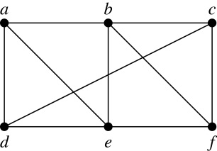
Paths (continued)
Example: In the simple graph here:
  a, d, c, f, e is a simple path of length 4.
  d, e, c, a is not a path because e is not connected to c.
  b, c, f, e, b is a circuit (or cycle) of length 4.
  a, b, e, d, a, b is a path of length 5, but it is not a simple path.

Slide 29
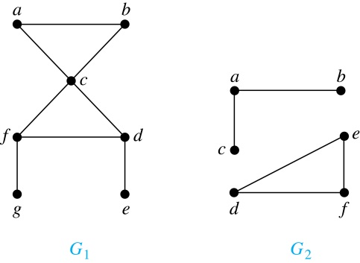
Connectedness in Undirected Graphs
Definition: An undirected graph is called connected if there is a path between every pair of vertices. An undirected graph that is not connected is called disconnected.
Example: G₁ is connected because there is a path between any pair of its vertices, as can be easily seen. However G₂ is not connected because there is no path between vertices a and f, for example.

Slide 30
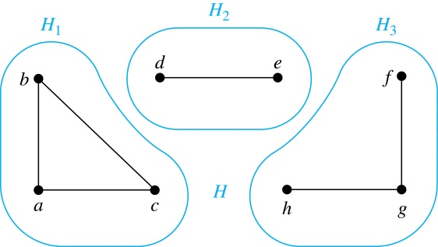
Connected Components
Definition: A connected component of a graph G is a connected subgraph of G that is not a proper subgraph of another connected subgraph of G. A graph G that is not connected has two or more connected components that are disjoint and have G as their union.
Example: The graph H is the union of three disjoint subgraphs H₁, H₂, and H₃, none of which are proper subgraphs of a larger connected subgraph of G.These three subgraphs are the connected components of H.

Slide 31
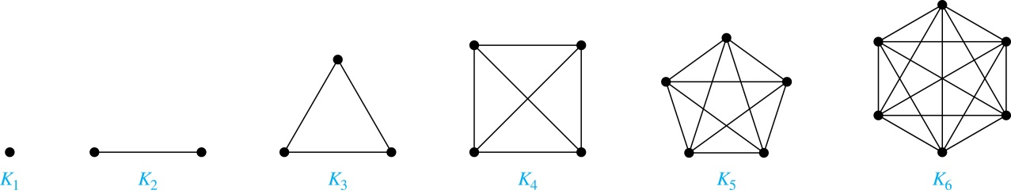
Special Types of Simple Graphs: Complete Graphs
A complete graph on n vertices, denoted by K_{n}, is the simple graph that contains exactly one edge between each pair of distinct vertices.

Slide 32
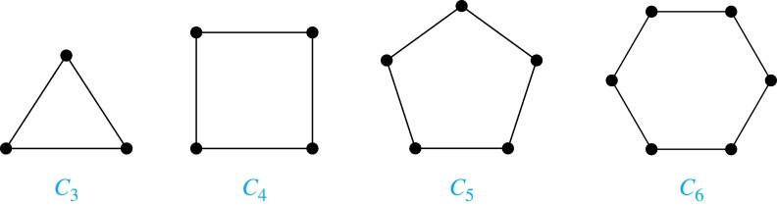
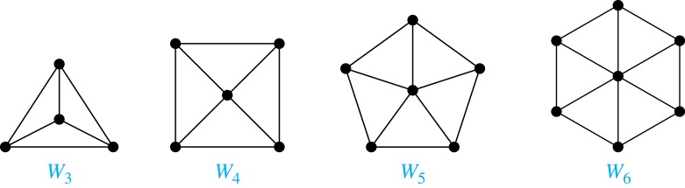
Special Types of Simple Graphs: Cycles and Wheels
A cycle C_{n} for n ≥ 3 consists of n vertices v₁, v₂ ,⋯ , v_{n}, and edges {v₁, v₂}, {v₂, v₃} ,⋯ , {v_{n-1}, v_{n}}, {v_{n}, v₁}.
A wheel W_{n} is obtained by adding an additional vertex to a cycle C_{n} for n ≥ 3 and connecting this new vertex to each of the n vertices in C_{n} by new edges.

Slide 33
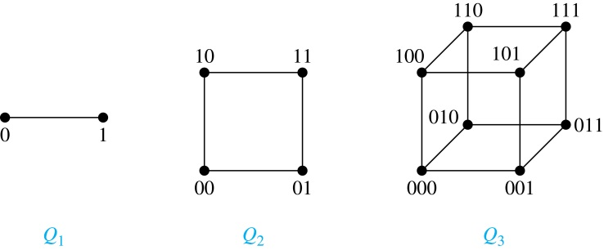
Special Types of Simple Graphs: n-Cubes
An n-dimensional hypercube, or n-cube, Q_{n}, is a graph with 2^{n} vertices representing all bit strings of length n, where there is an edge between two vertices that differ in exactly one bit position.

Slide 34
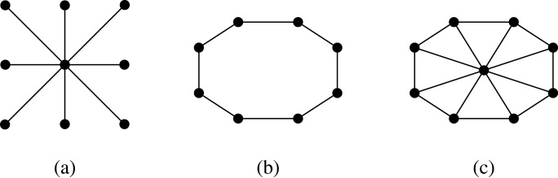
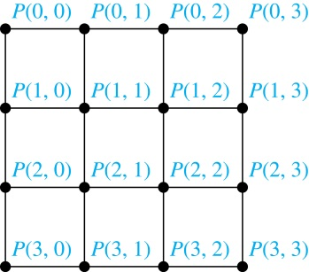
Special Types of Graphs and Computer Network Architecture
Various special graphs play an important role in the design of computer networks.
Some local area networks use a star topology, which is a complete bipartite graph K_{1,n} ,as shown in (a). All devices are connected to a central control device.
Other local networks are based on a ring topology, where each device is connected to exactly two others using C_{n} ,as illustrated in (b). Messages may be sent around the ring.
Others, as illustrated in (c), use a W_{n} – based topology, combining the features of a star topology and a ring topology.
Various special graphs also play a role in parallel processing where processors need to be interconnected as one processor may need the output generated by another.
  The n-dimensional hypercube, or n-cube, Q_{n}, is a common way to connect processors in parallel, e.g., Intel Hypercube.
  Another common method is the mesh network, illustrated here for 16 processors.

Slide 35
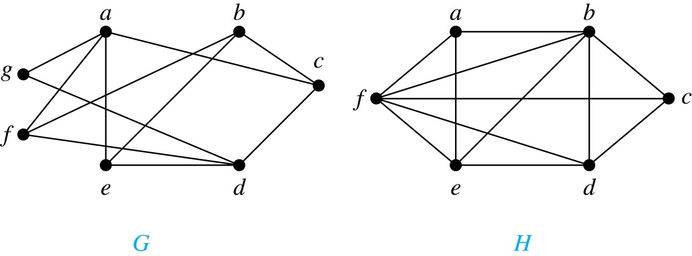
Bipartite Graphs
Definition: A simple graph G is bipartite if V can be partitioned into two disjoint subsets V₁ and V₂ such that every edge connects a vertex in V₁ and a vertex in V₂. In other words, there are no edges which connect two vertices in V₁ or in V₂.
It is not hard to show that an equivalent definition of a bipartite graph is a graph where it is possible to color the vertices red or blue so that no two adjacent vertices are the same color.
H is not bipartite
since if we color a red, then the adjacent vertices f and b must both be blue.
G is bipartite

Slide 36
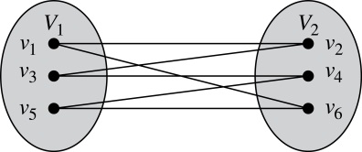
Bipartite Graphs (continued)
Example: Show that C₆ is bipartite.
Solution: We can partition the vertex set into V₁ = {v₁, v₃, v₅} and V₂ = {v₂, v₄, v₆} so that every edge of C₆ connects a vertex in V₁ and V₂ .
Example: Show that C₃ is not bipartite.
Solution: If we divide the vertex set of C₃ into two nonempty sets, one of the two must contain two vertices. But in C₃ every vertex is connected to every other vertex. Therefore, the two vertices in the same partition are connected. Hence, C₃ is not bipartite.

Slide 37
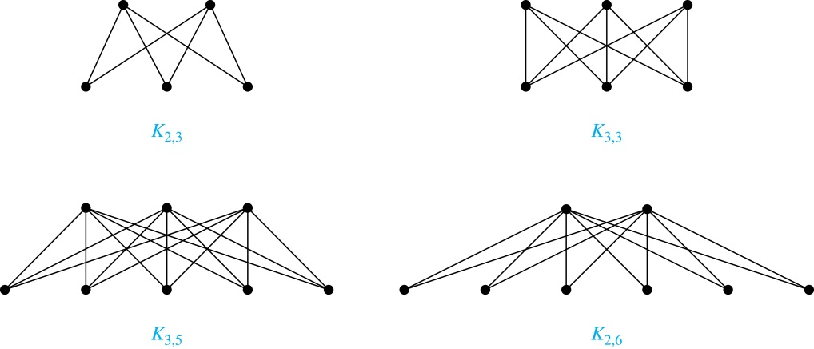
Complete Bipartite Graphs
Definition: A complete bipartite graph K_{m,n} is a graph that has its vertex set partitioned into two subsets V₁ of size m and V₂ of size n such that there is an edge from every vertex in V₁ to every vertex in V₂.
Example: We display four complete bipartite graphs here.

Slide 38
Isomorphism of Graphs
Definition: The simple graphs G₁ = (V₁, E₁) and G₂ = (V₂, E₂) are isomorphic if there is a one-to-one and onto function f from V₁ to V₂ with the property that a and b are adjacent in G₁ if and only if f(a) and f(b) are adjacent in G₂ , for all a and b in V₁ . Such a function f is called an isomorphism. Two simple graphs that are not isomorphic are called nonisomorphic.

Slide 39
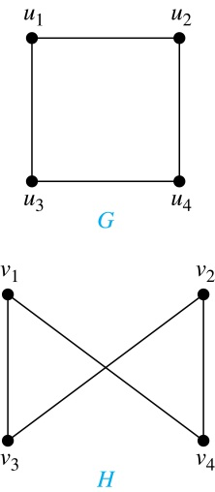
Isomorphism of Graphs (cont.)
Example: Show that the graphs G =(V, E) and H = (W, F) are isomorphic.
Solution: The function f with f(u₁) = v₁,
f(u₂) = v₄, f(u₃) = v₃, and f(u₄) = v₂ is a
one-to-one correspondence between V and W. Note that adjacent vertices in G are u₁ and u₂, u₁ and u₃, u₂ and u₄, and u₃ and u₄. Each of the pairs f(u₁) = v₁ and f(u₂) = v₄, f(u₁) = v₁ and f(u₃) = v₃ , f(u₂) = v₄ and f(u₄) = v₂ , and f(u₃) = v₃ and f(u₄) = v₂ consists of two adjacent vertices in H.

Slide 40
Isomorphism of Graphs (cont.)
It is difficult to determine whether two simple graphs are isomorphic using brute force because there are n! possible one-to-one correspondences between the vertex sets of two simple graphs with n vertices.
The best algorithms for determining weather two graphs are isomorphic have exponential worst case complexity in terms of the number of vertices of the graphs.
Sometimes it is not hard to show that two graphs are not isomorphic. We can do so by finding a property, preserved by isomorphism, that only one of the two graphs has. Such a property is called graph invariant.
There are many different useful graph invariants that can be used to distinguish nonisomorphic graphs, such as the number of vertices, number of edges, and degree sequence (list of the degrees of the vertices in nonincreasing order). We will encounter others in later sections of this chapter.

Slide 41
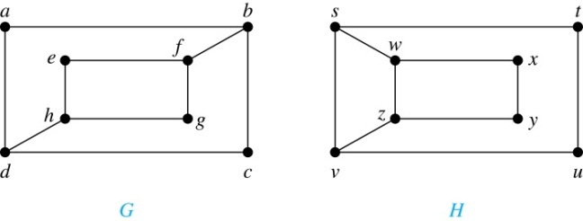
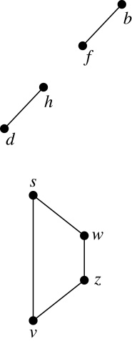
Isomorphism of Graphs (cont.)
Example: Determine whether these two graphs are isomorphic.
Solution: Both graphs have eight vertices and ten edges.
They also both have four vertices of degree two and four of degree three.
However, G and H are not isomorphic. Note that since deg(a) = 2 in G, a must correspond to t, u, x, or y in H, because these are the vertices of degree 2. But each of these vertices is adjacent to another vertex of degree two in H, which is not true for a in G.
Alternatively, note that the subgraphs of G and H made up of vertices of
degree three and the edges connecting them must be isomorphic.
But the subgraphs, as shown at the right, are not isomorphic.

Slide 42
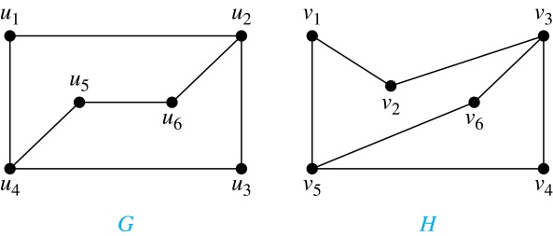
Isomorphism of Graphs (cont.)
Example: Determine whether these two graphs are isomorphic.
Solution: Both graphs have six vertices and seven edges.
They also both have four vertices of degree two and two of degree three.
The subgraphs of G and H consisting of all the vertices of degree two and the edges connecting them are isomorphic. So, it is reasonable to try to find an isomorphism f.
We define an injection f from the vertices of G to the vertices of H that preserves the degree of vertices. We will determine whether it is an isomorphism.
The function f with f(u₁) = v₆, f(u₂) = v₃, f(u₃) = v₄, and f(u₄) = v₅ , f(u₅) = v₁, and f(u₆) = v₂ is a one-to-one correspondence between G and H. Showing that this correspondence preserves edges is straightforward, so we will omit the details here. Because f is an isomorphism, it follows that G and H are isomorphic graphs.
See the text for an illustration of how adjacency matrices can be used for this verification.

Slide 43
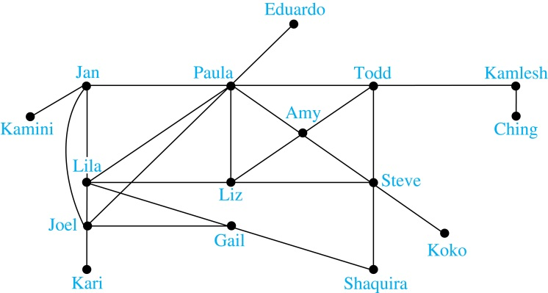
Degrees of Separation
Example: Paths in Acquaintanceship Graphs. In an acquaintanceship graph there is a path between two people if there is a chain of people linking these people, where two people adjacent in the chain know one another. In this graph there is a chain of six people linking Kamini and Ching.
Some have speculated that almost every pair of people in the world are linked by a small chain of no more than six, or maybe even, five people. The play Six Degrees of Separation by John Guare is based on this notion.

Slide 44

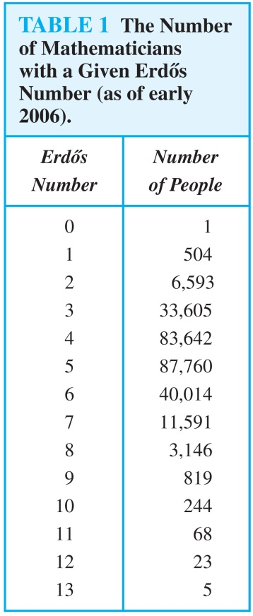
Erdős numbers
Paul Erdős
Example: Erdős numbers. In a collaboration graph, two people a and b are connected by a path when there is a sequence of people starting with a and ending with b such that the endpoints of each edge in the path are people who have collaborated.
In the academic collaboration graph of people who have written papers in mathematics, the Erdős number of a person m is the length of the shortest path between m and the prolific mathematician Paul Erdős.
  To learn more about Erdős numbers, visit
  http://www.ams.org/mathscinet/collaborationDistance.html

Slide 45
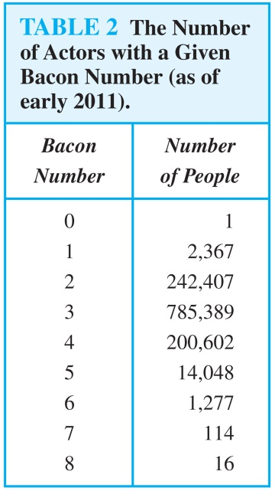
Bacon Numbrers
In the Hollywood graph, two actors a and b are linked when there is a chain of actors linking a and b, where every two actors adjacent in the chain have acted in the same movie.
The Bacon number of an actor c is defined to be the length of the shortest path connecting c and the well-known actor Kevin Bacon. (Note that we can define a similar number by replacing Kevin Bacon by a different actor.)
  The oracle of Bacon web site http://oracleofbacon.org/how.php provides a tool for finding Bacon numbers.

Slide 46
The Connected Components of the Web Graph
Recall that at any particular instant the web graph provides a snapshot of the web, where vertices represent web pages and edges represent links. According to a 1999 study, the Web graph at that time had over 200 million vertices and over 1.5 billion edges. (The numbers today are several orders of magnitude larger.)
The underlying undirected graph of this Web graph has a connected component that includes approximately 90% of the vertices.
There is a giant strongly connected component (GSCC) consisting of more than 53 million vertices. A Web page in this component can be reached by following links starting in any other page of the component. There are three other categories of pages with each having about 44 million vertices:
  pages that can be reached from a page in the GSCC, but do not link back.
  pages that link back to the GSCC, but can not be reached by following links from pages in the GSCC.
  pages that cannot reach pages in the GSCC and can not be reached from pages in the GSCC.

Slide 47
Euler Paths and Circuits
Leonard Euler (1707-1783)
The town of Kӧnigsberg, Prussia (now Kalingrad, Russia) was divided into four sections by the branches of the Pregel river. In the 18th century seven bridges connected these regions.
People wondered whether whether it was possible to follow a path that crosses each bridge exactly once and returns to the starting point.
The Swiss mathematician Leonard Euler proved that no such path exists. This result is often considered to be the first theorem ever proved in graph theory.
Multigraph Model of the Bridges of Kӧnigsberg
The 7 Bridges of Kӧnigsberg

Slide 48
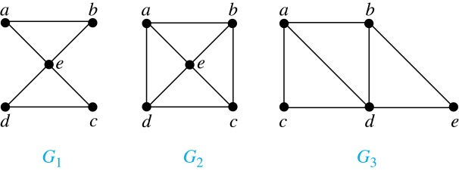
Euler Paths and Circuits (continued)
Definition: An Euler circuit in a graph G is a simple circuit containing every edge of G. An Euler path in G is a simple path containing every edge of G.
Example: Which of the undirected graphs G₁, G₂, and G₃ has a Euler circuit? Of those that do not, which has an Euler path?
Solution: The graph G₁ has an Euler circuit (e.g., a, e, c, d, e, b, a). But, as can easily be verified by inspection, neither G₂ nor G₃ has an Euler circuit. Note that G₃ has an Euler path (e.g., a, c, d, e, b, d, a, b), but there is no Euler path in G₂, which can be verified by inspection.

Slide 49
Necessary Conditions for Euler Circuits and Paths
An Euler circuit begins with a vertex a and continues with an edge incident with a, say {a, b}. The edge {a, b} contributes one to deg(a).
Each time the circuit passes through a vertex it contributes two to the vertex’s degree.
Finally, the circuit terminates where it started, contributing one to deg(a). Therefore deg(a) must be even.
We conclude that the degree of every other vertex must also be even.
By the same reasoning, we see that the initial vertex and the final vertex of an Euler path have odd degree, while every other vertex has even degree. So, a graph with an Euler path has exactly two vertices of odd degree.
In the next slide we will show that these necessary conditions are also sufficient conditions.

Slide 50
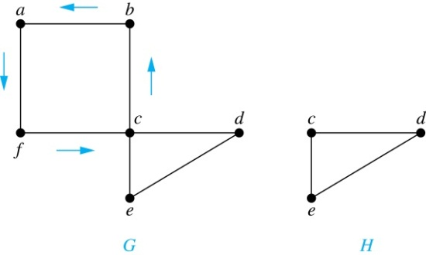
Sufficient Conditions for Euler Circuits and Paths
Suppose that G is a connected multigraph with ≥ 2 vertices, all of even degree. Let x₀ = a be a vertex of even degree. Choose an edge {x₀, x₁} incident with a and proceed to build a simple path {x₀, x₁}, {x₁, x₂}, …, {x_{n-1}, x_{n}} by adding edges one by one until another edge can not be added.
The path begins at a with an edge of the form {a, x}; we show that it must terminate at a with an edge of the form {y, a}. Since each vertex has an even degree, there must be an even number of edges incident with this vertex. Hence, every time we enter a vertex other than a, we can leave it. Therefore, the path can only end at a.
If all of the edges have been used, an Euler circuit has been constructed. Otherwise, consider the subgraph H obtained from G by deleting the edges already used.
We illustrate this idea in the graph G here. We begin at a and choose the edges {a, f}, {f, c}, {c, b}, and {b, a} in succession.
In the example H consists of the vertices c, d, e.

Slide 51
Sufficient Conditions for Euler Circuits and Paths (continued)
Because G is connected, H must have at least one vertex in common with the circuit that has been deleted.
Every vertex in H must have even degree because all the vertices in G have even degree and for each vertex, pairs of edges incident with this vertex have been deleted. Beginning with the shared vertex construct a path ending in the same vertex (as was done before). Then splice this new circuit into the original circuit.
Continue this process until all edges have been used. This produces an Euler circuit. Since every edge is included and no edge is included more than once.
Similar reasoning can be used to show that a graph with exactly two vertices of odd degree must have an Euler path connecting these two vertices of odd degree
In the example, the vertex is c.
In the example, we end up with the circuit a, f, c, d, e, c, b, a.

Slide 52
Algorithm for Constructing an Euler Circuits
In our proof we developed this algorithms for constructing a Euler circuit in a graph with no vertices of odd degree.
procedure Euler(G: connected multigraph with all vertices of even degree)
circuit := a circuit in G beginning at an arbitrarily chosen vertex with edges
successively added to form a path that returns to this vertex.
H := G with the edges of this circuit removed
while H has edges
subciruit := a circuit in H beginning at a vertex in H that also is
an endpoint of an edge in circuit.
H := H with edges of subciruit and all isolated vertices removed
circuit := circuit with subcircuit inserted at the appropriate vertex.
return circuit{circuit is an Euler circuit}

Slide 53
Necessary and Sufficient Conditions for Euler Circuits and Paths (continued)
Theorem: A connected multigraph with at least two vertices has an Euler circuit if and only if each of its vertices has an even degree and it has an Euler path if and only if it has exactly two vertices of odd degree.
Example: Two of the vertices in the multigraph model of the Kӧnigsberg bridge problem have odd degree. Hence, there is no Euler circuit in this multigraph and it is impossible to start at a given point, cross each bridge exactly once, and return to the starting point.

Slide 54
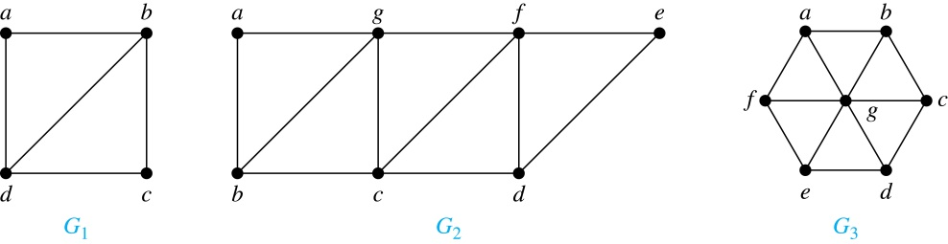
Euler Circuits and Paths
Example:
G₁ contains exactly two vertices of odd degree (b and d). Hence it has an Euler path, e.g., d, a, b, c, d, b.
G₂ has exactly two vertices of odd degree (b and d). Hence it has an Euler path, e.g., b, a, g, f, e, d, c, g, b, c, f, d.
G₃ has six vertices of odd degree. Hence, it does not have an Euler path.

Slide 55
Applications of Euler Paths and Circuits
Euler paths and circuits can be used to solve many practical problems such as finding a path or circuit that traverses each
  street in a neighborhood,
  road in a transportation network,
  connection in a utility grid,
  link in a communications network.
Other applications are found in the
  layout of circuits,
  network multicasting,
  molecular biology, where Euler paths are used in the sequencing of DNA.

Slide 56
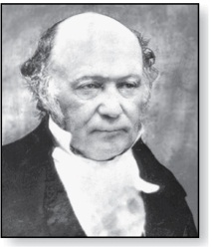
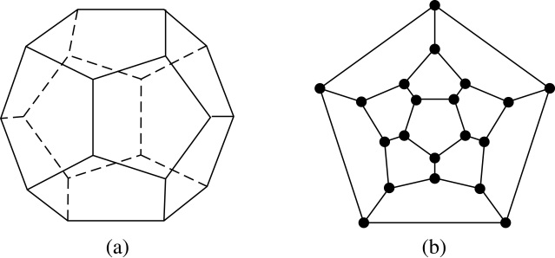
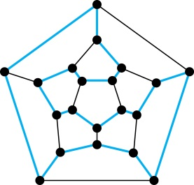
Hamilton Paths and Circuits
William Rowan Hamilton (1805- 1865)
Euler paths and circuits contained every edge only once. Now we look at paths and circuits that contain every vertex exactly once.
William Hamilton invented the Icosian puzzle in 1857. It consisted of a wooden dodecahedron (with 12 regular pentagons as faces), illustrated in (a), with a peg at each vertex, labeled with the names of different cities. String was used to used to plot a circuit visiting 20 cities exactly once
The graph form of the puzzle is given in (b).
The solution (a Hamilton circuit) is given here.

Slide 57
Hamilton Paths and Circuits
Definition: A simple path in a graph G that passes through every vertex exactly once is called a Hamilton path, and a simple circuit in a graph G that passes through every vertex exactly once is called a Hamilton circuit.
That is, a simple path x₀, x₁, …, x_{n-1}, x_{n} in the graph G = (V, E) is called a Hamilton path if V = {x₀, x₁, … , x_{n-1,} x_{n} } and x_{i} ≠ x_{j} for 0≤ i < j ≤ n, and the simple circuit x₀, x₁, …, x_{n-1}, x_{n}, x₀ (with n > 0) is a Hamilton circuit if x₀, x₁, … , x_{n-1}, x_{n} is a Hamilton path.

Slide 58
Hamilton Paths and Circuits (continued)
Example: Which of these simple graphs has a Hamilton circuit or, if not, a Hamilton path?
Solution: G₁ has a Hamilton circuit: a, b, c, d, e, a.
G₂ does not have a Hamilton circuit (Why?), but does have a Hamilton path : a, b, c, d.
G₃ does not have a Hamilton circuit, or a Hamilton path. Why?

Slide 59
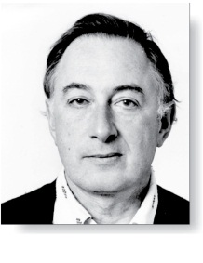
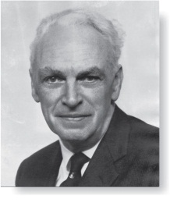
Necessary Conditions for
Hamilton Circuits
Gabriel Andrew Dirac
(1925-1984)
Unlike for an Euler circuit, no simple necessary and sufficient conditions are known for the existence of a Hamiton circuit.
However, there are some useful necessary conditions. We describe two of these now.
Dirac’s Theorem: If G is a simple graph with n ≥ 3 vertices such that the degree of every vertex in G is ≥ n/2, then G has a Hamilton circuit.
Ore’s Theorem: If G is a simple graph with n ≥ 3 vertices such that deg(u) + deg(v) ≥ n for every pair of nonadjacent vertices, then G has a Hamilton circuit.
Øysten Ore
(1899-1968)

Slide 60
Applications of Hamilton Paths and Circuits
Applications that ask for a path or a circuit that visits each intersection of a city, each place pipelines intersect in a utility grid, or each node in a communications network exactly once, can be solved by finding a Hamilton path in the appropriate graph.
The famous traveling salesperson problem (TSP) asks for the shortest route a traveling salesperson should take to visit a set of cities. This problem reduces to finding a Hamilton circuit such that the total sum of the weights of its edges is as small as possible.
A family of binary codes, known as Gray codes, which minimize the effect of transmission errors, correspond to Hamilton circuits in the n-cube Q_{n}. (See the text for details.)

