Slide 1
Introduction to Trees
Section 11.1

Slide 2
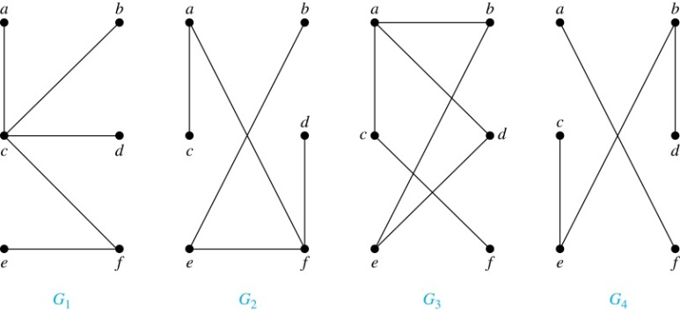
Trees
Definition: A tree is a connected undirected graph with no simple circuits (or cycles).
Example: Which of these graphs are trees?
Solution: G₁ and G₂ are trees - both are connected and have no simple circuits. Because e, b, a, d, e is a simple circuit, G₃ is not a tree. G₄ is not a tree because it is not connected.

Slide 3
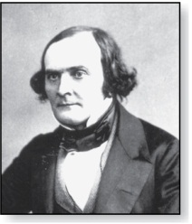
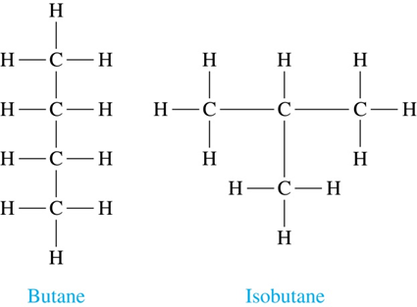
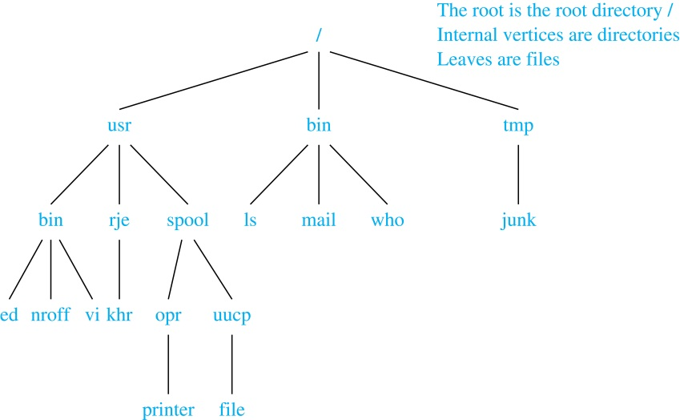

Trees as Models
Arthur Cayley
(1821-1895)
Trees are used as models in computer science, chemistry, geology, botany, psychology, and many other areas.
Trees were introduced by the mathematician Cayley in 1857 in his work counting the number of isomers of saturated hydrocarbons. The two isomers of butane are shown at the right.
The organization of a computer file system into directories, subdirectories, and files is naturally represented as a tree.
Trees are used to represent the structure of organizations.

Slide 4
Properties of Trees
Theorem: A tree with n vertices has n − 1 edges.
Proof (by mathematical induction):
BASIS STEP: When n = 1, a tree with one vertex has no edges. Hence, the theorem holds when n = 1.
INDUCTIVE STEP: Assume that every tree with k vertices has k − 1 edges.
Suppose that a tree T has k + 1 vertices and that v is a leaf of T. Let w be the parent of v. Removing the vertex v and the edge connecting w to v produces a tree T′ with k vertices. By the inductive hypothesis, T′ has k − 1 edges. Because T has one more edge than T′, we see that T has k edges. This completes the inductive step.

Slide 5
Trees (continued)
Theorem: An undirected graph is a tree if and only if there is a unique simple path between any two of its vertices.
Proof: Assume that T is a tree. Then T is connected with no simple circuits. Hence, if x and y are distinct vertices of T, there is a simple path between them (by Theorem 1 of Section 10.4). This path must be unique - for if there were a second path, there would be a simple circuit in T (by Exercise 59 of Section 10.4). Hence, there is a unique simple path between any two vertices of a tree.
Now assume that there is a unique simple path between any two vertices of a graph T. Then T is connected because there is a path between any two of its vertices. Furthermore, T can have no simple circuits since if there were a simple circuit, there would be two paths between some two vertices.
Hence, a graph with a unique simple path between any two vertices is a tree.

Slide 6
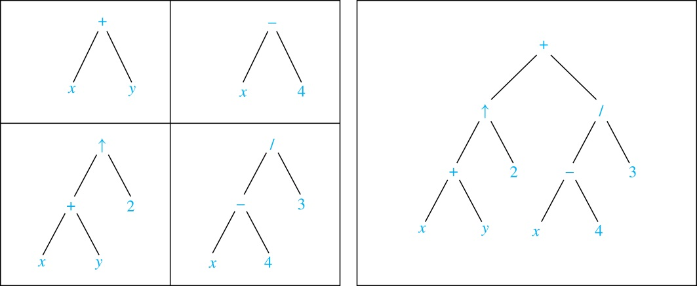
Expression Trees
Complex expressions can be represented using ordered rooted trees.
Consider the expression ((x + y) ↑ 2 ) + ((x − 4)/3).
A binary tree for the expression can be built from the bottom up, as is illustrated here.

